Slide 1
MyIM Review

Slide 2
AGENDA – DAY 1
9.00 – 9.45
Review of business objectives / scope / personas
10.00 – 12.00
Review of product with E2E scenarios:
  MYIM Failure Closure
  MYIM Portal – Create Failure, Edit Failure
    MWM Mobile - View and Submit Failure
    MYIM Portal – Close Failure
  MWM Portal - Failure Form Approval
  SINCS - Create, Edit and Approve SINCS file
12.00 – 12.30
Lunch Break
12.30 – 14.30
Overview of each component of the system at a high level physical building block level
14.30 – 16.30
Walkthrough of the high level architecture vs what has been built
  Technical Debt
  Deviations from design
  Risks / Issues

Slide 3
Business Objectives, Scope & Personas

Slide 4
Objectives:
To replacing the current architecture consisting of FMS Central and 9 instances of FMS Local with a browser based web application (MyIM) for route controllers SINCS users and a common iOS based mobile application for field users. The mobile application capability will be part of Mobile Works Manager (MWM) project
Data Migration of Central and local databases
Decommission FMS and the FCL application
Business Processes:
Creation of fault records
Notification of mobile teams
Definition of defects and Trust
SINCS / TINCS
Reporting
Business Users:
Mobile Work Teams (15K)
Controllers (1.5K)
SINCS (0.1 K)

Slide 5
Scope
ID | In Scope | Out of Scope
1 | MyIM Web Solution Single web solution for Route Controllers and SINCS Users to manage end-to-end fault management lifecycle. This will replace FMS Central, nine instance of FMS Local | It will not replace Fault Look-up Code (FCL) app. MWM Mobile is separate project which will be replacing FCL App.
2 | Reporting Solution Failure from MyIM application will be made available in the MyIM DataMart in Azure for other business users to consume as required. The MyIM DataMart will utilise available data like Asset, Asset Attributes and PSS / Trust datasets from ADS DataMart (cloud) to enable downstream reporting using Power BI reporting tool. | Availability of PSS/TRUST dataset for Power BI reports
3 | Failure history from current FMS Local instances and SINCS history from current FMS Central. One time migration of all failure history from FMS Local(s) and SINCS data from FMS Central to new MyIM database
4 | Database The MyIM database that will be created and managed for MyIM application requirement to store all the failure transactions DIM Tables will be created and managed in DataMart by MyIM for storing failure transaction to support downstream applications | Overall design of Azure DataMart or any upgrade to ADS DataMart (cloud).

Slide 6
Integration Architecture

Slide 8
End To End Demonstration

Slide 9
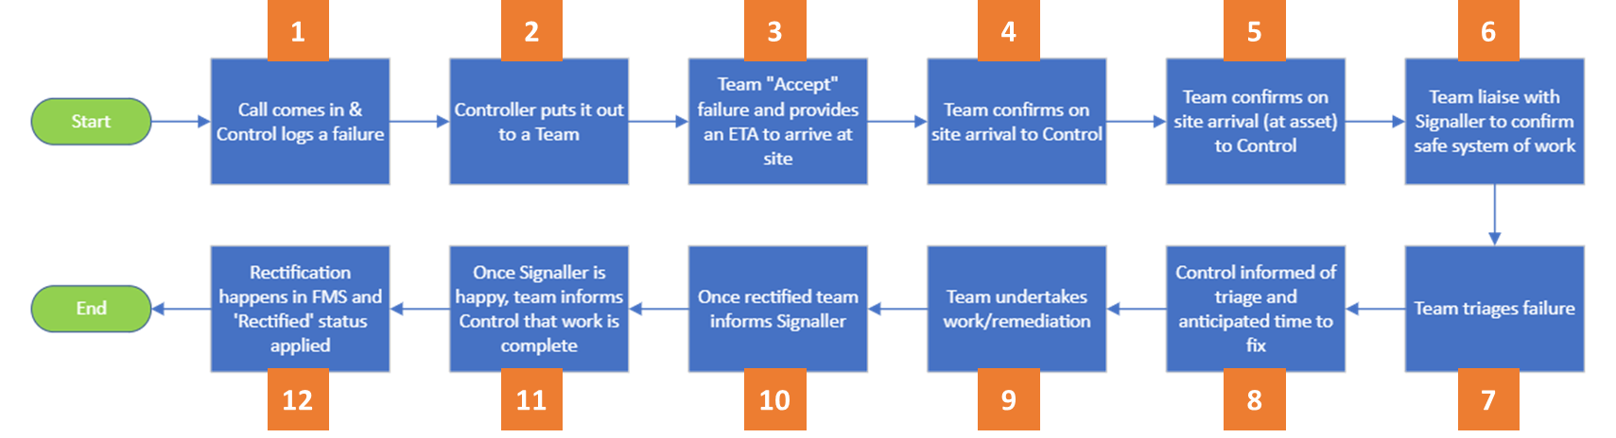
End to End flow –
Failure Creation on MYIM to Closure on MYIM
1. Call comes in and Controller Create Failure in MYIM
2.Controller Assigns Failure ID to a Team
3. Failure ID Available On MyWork App
3. Team Accepts Failure On App
4-10 Fill Failure form details and Submit Form on MyWork App
11-12.Close Failure on MYIM Portal
Failure moves to Recently Submitted tab

Slide 10
MYIM Portal

Slide 11
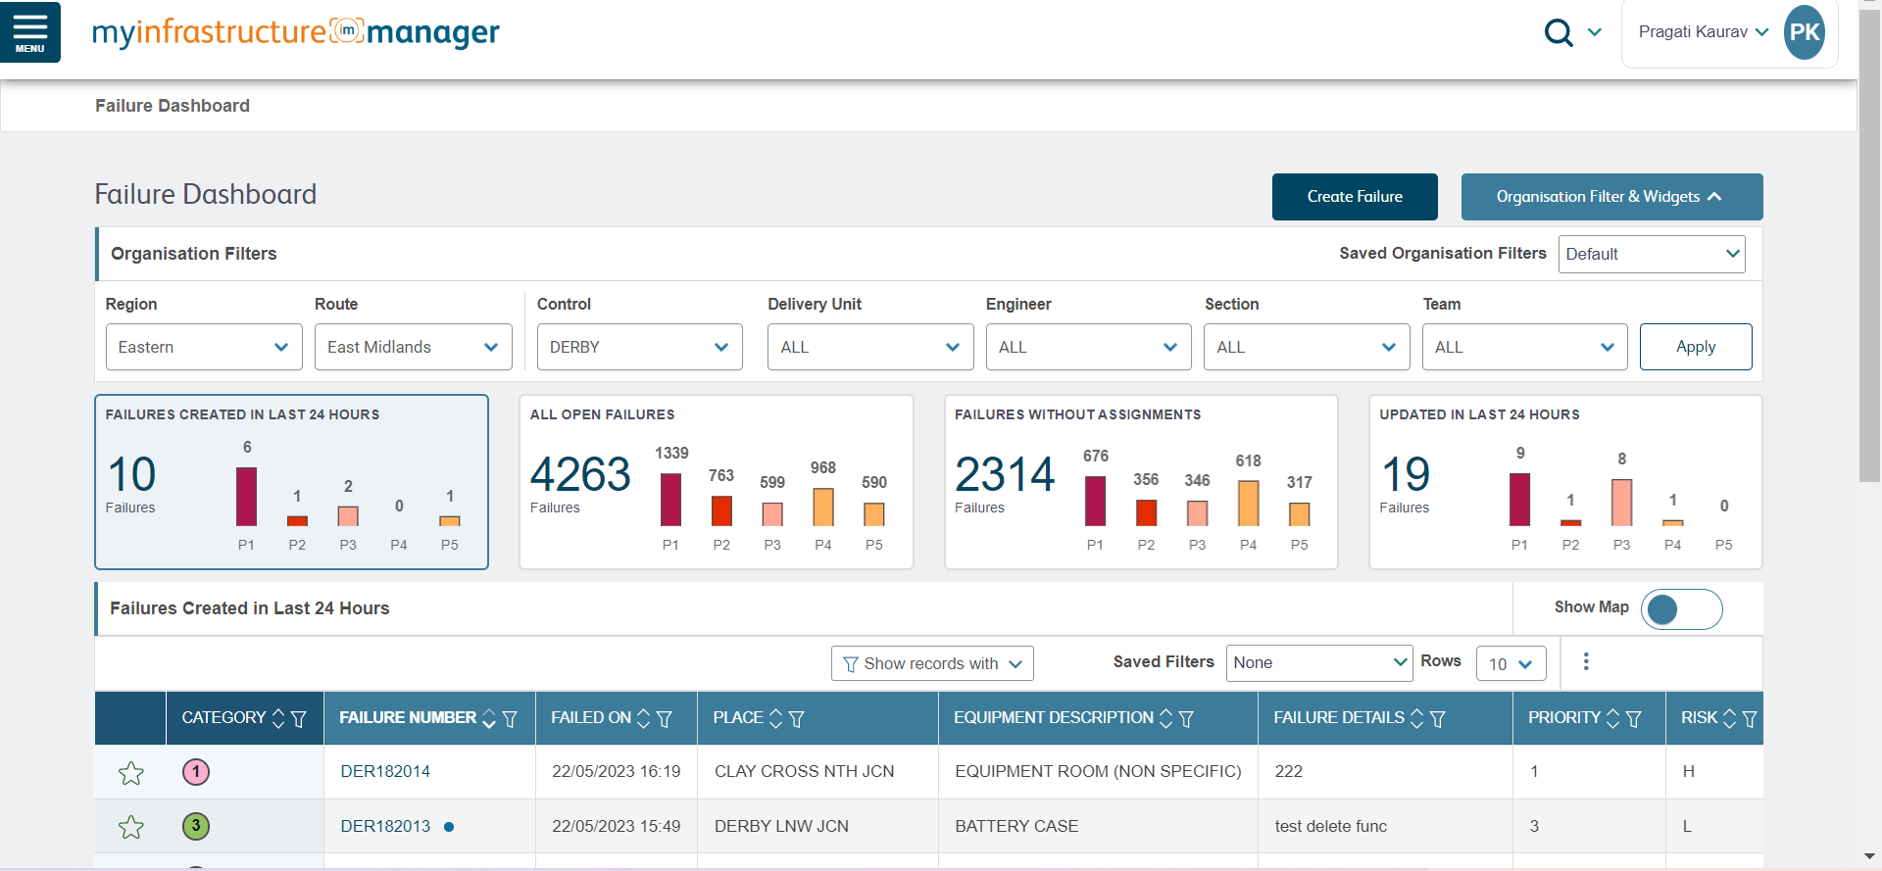
Create New Failure

Slide 12
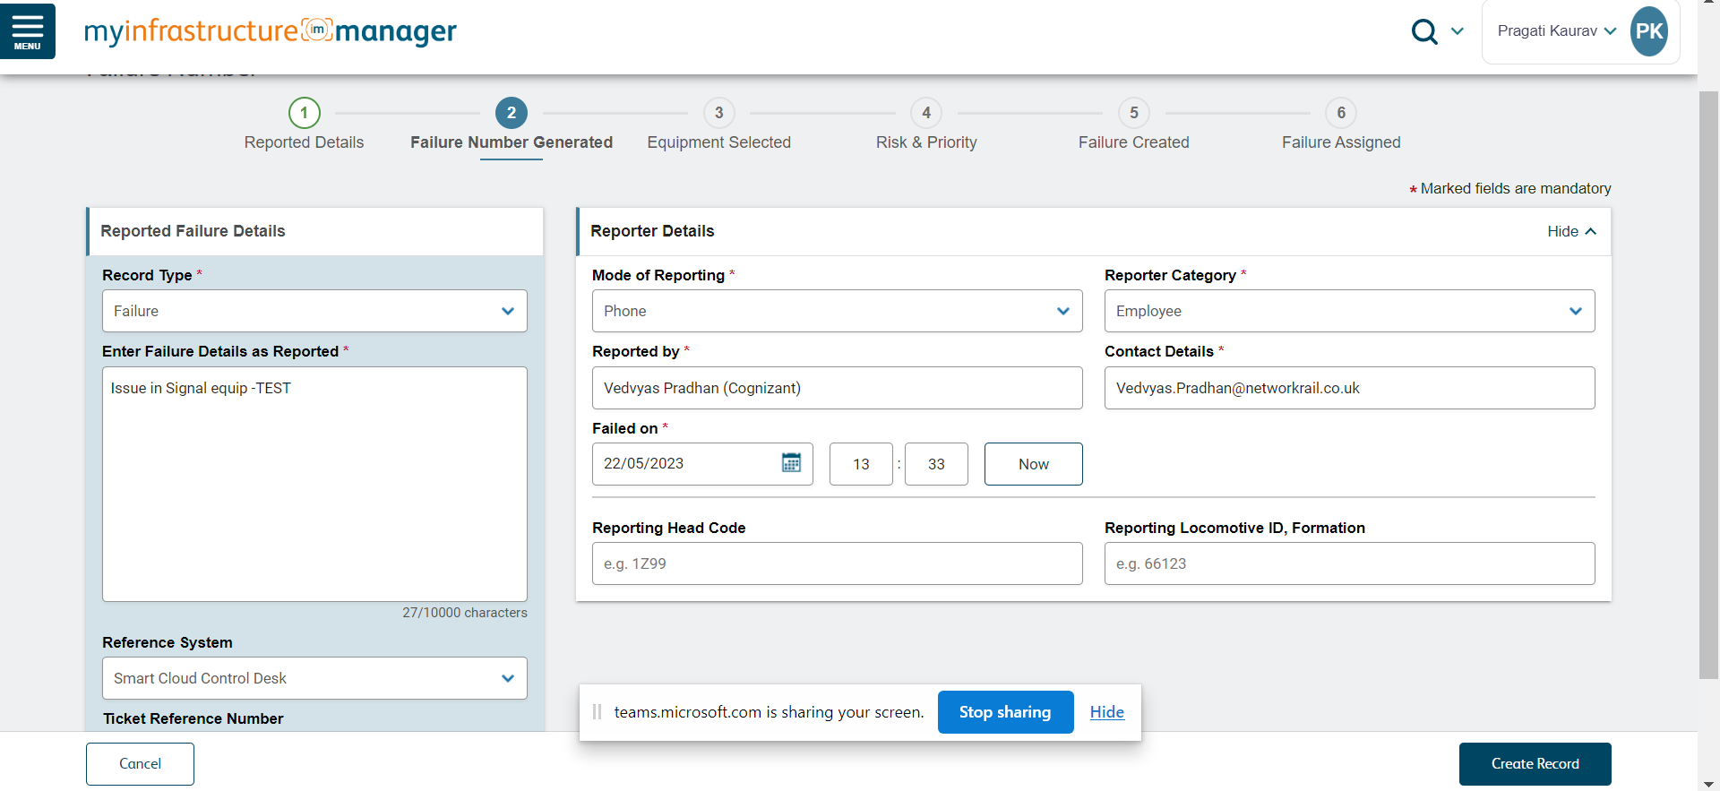
Provide Failure Details – Step 1

Slide 13
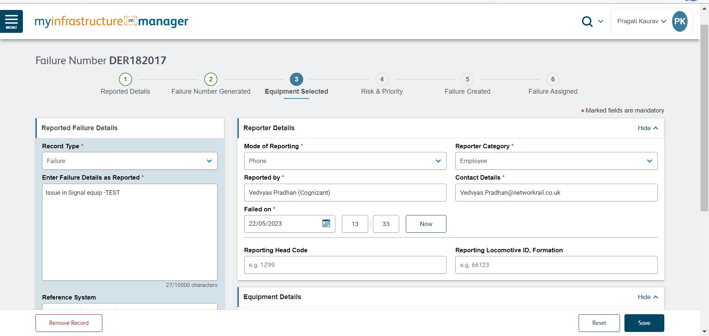
Provide Failure Details – Step 2

Slide 14
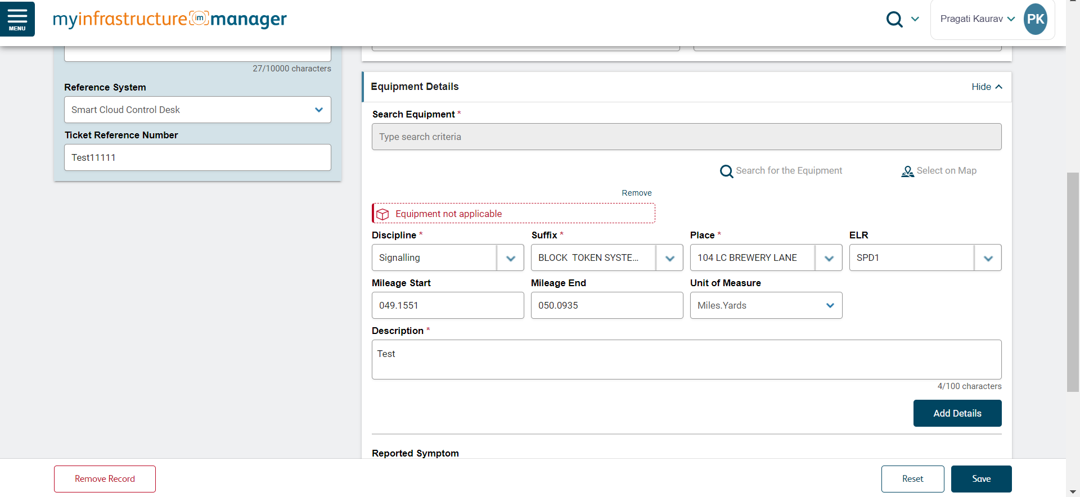
Provide Failure Details – Step 3

Slide 15
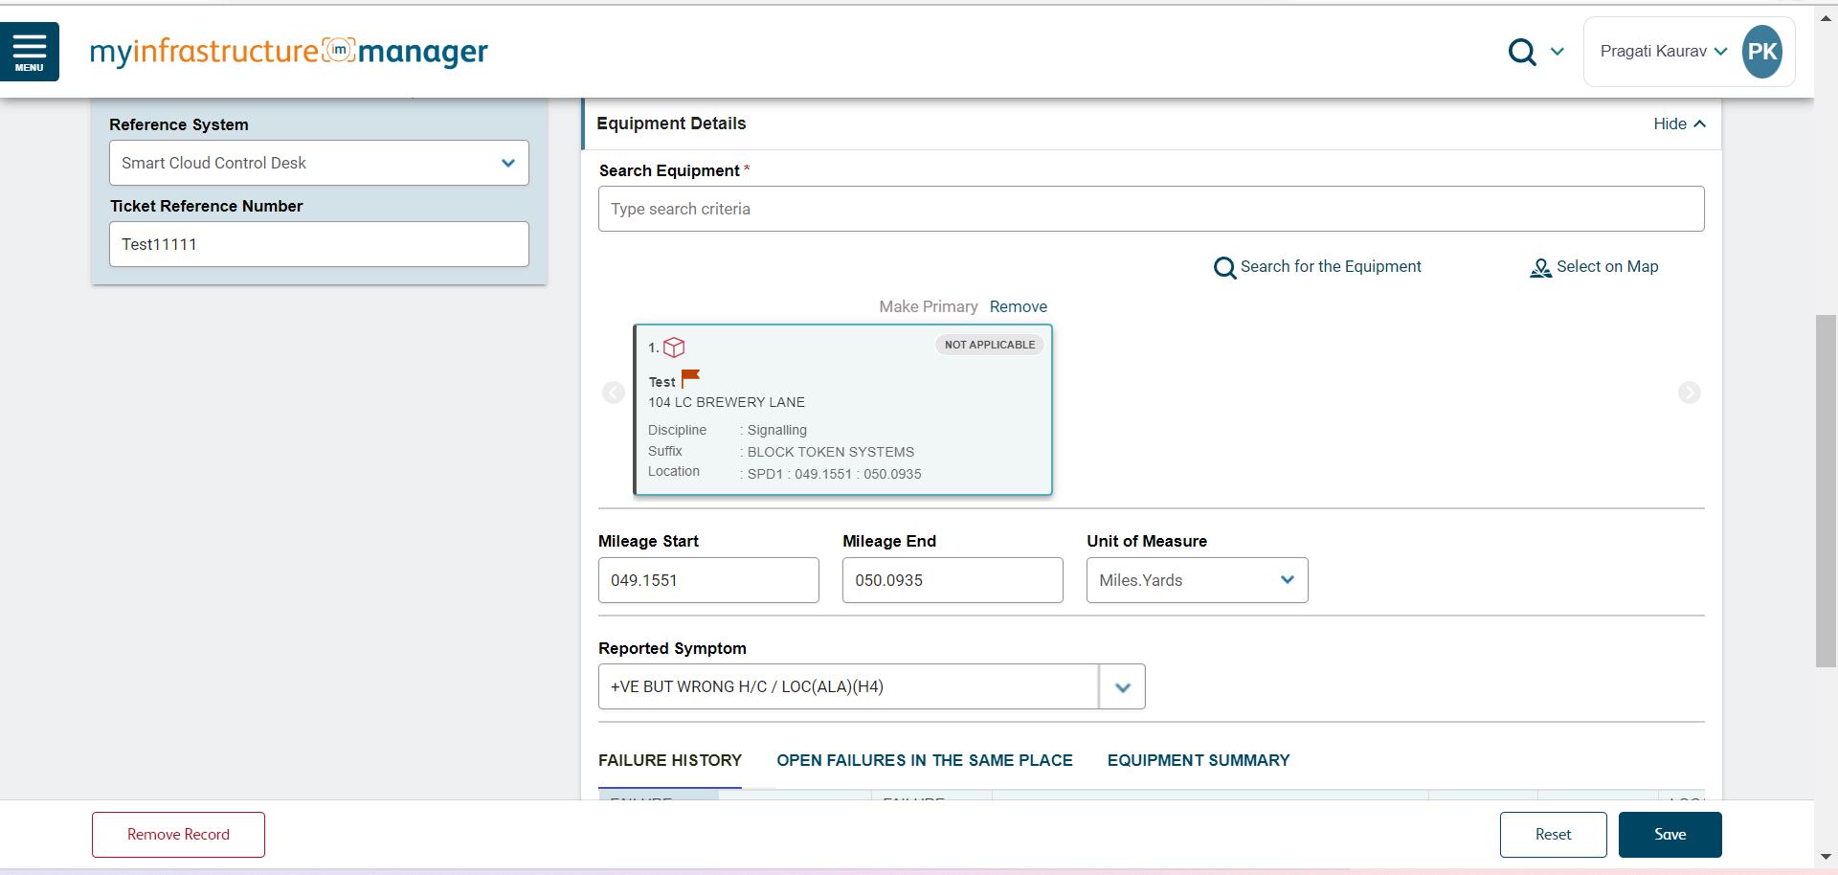
Provide Failure Details - Step 4

Slide 16
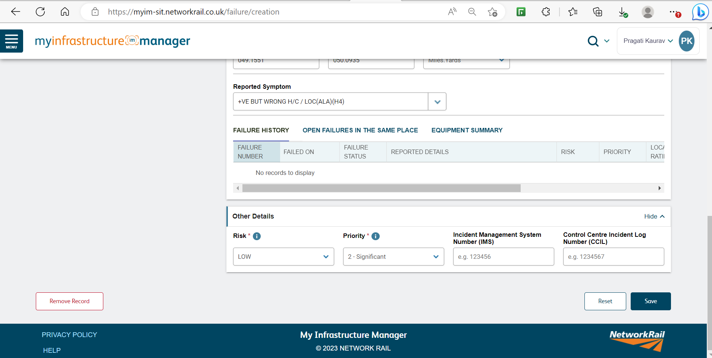
Provide Failure Details - Step 5

Slide 17
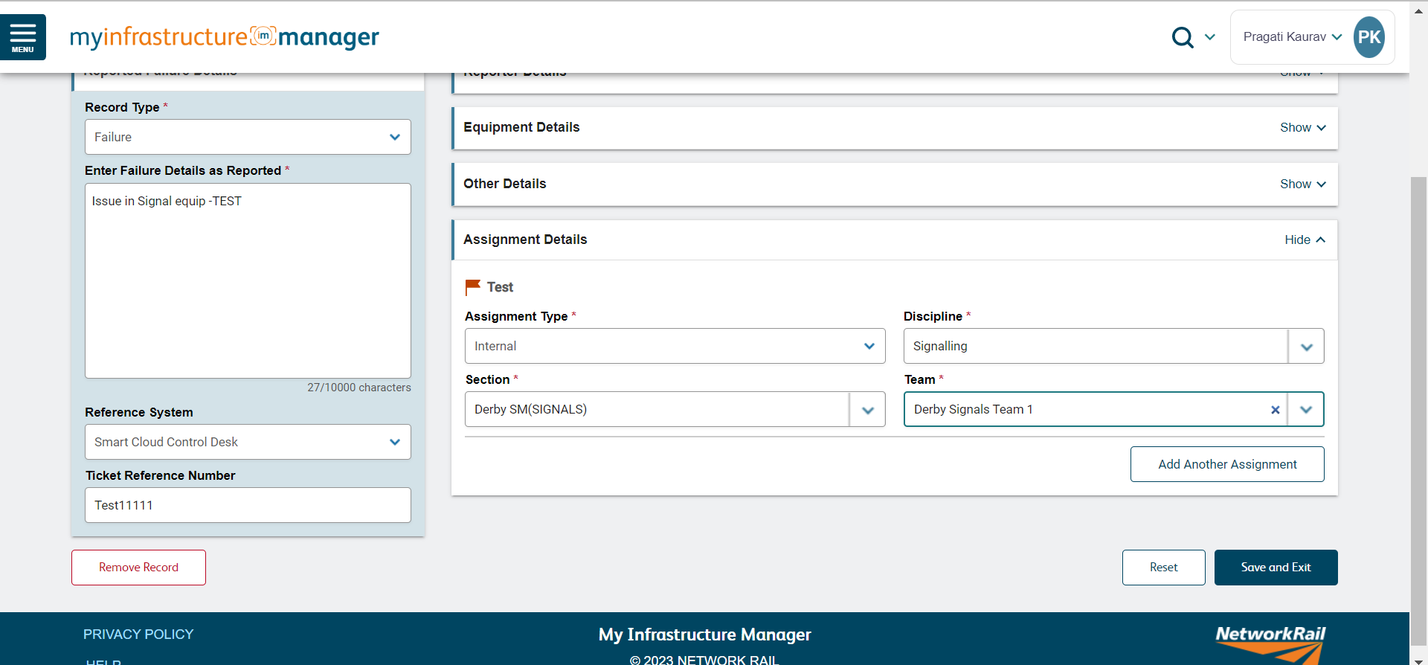
Actions: Save Failure Details / Remove/ Reset

Slide 18
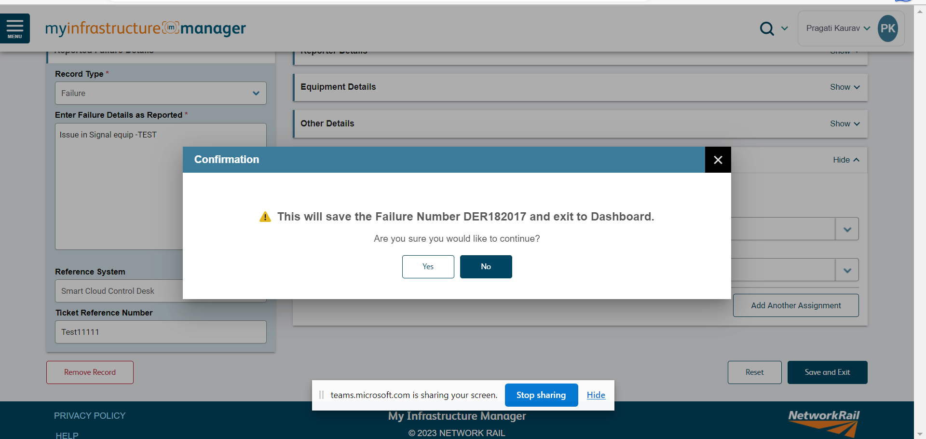
Save Failure Details

Slide 19
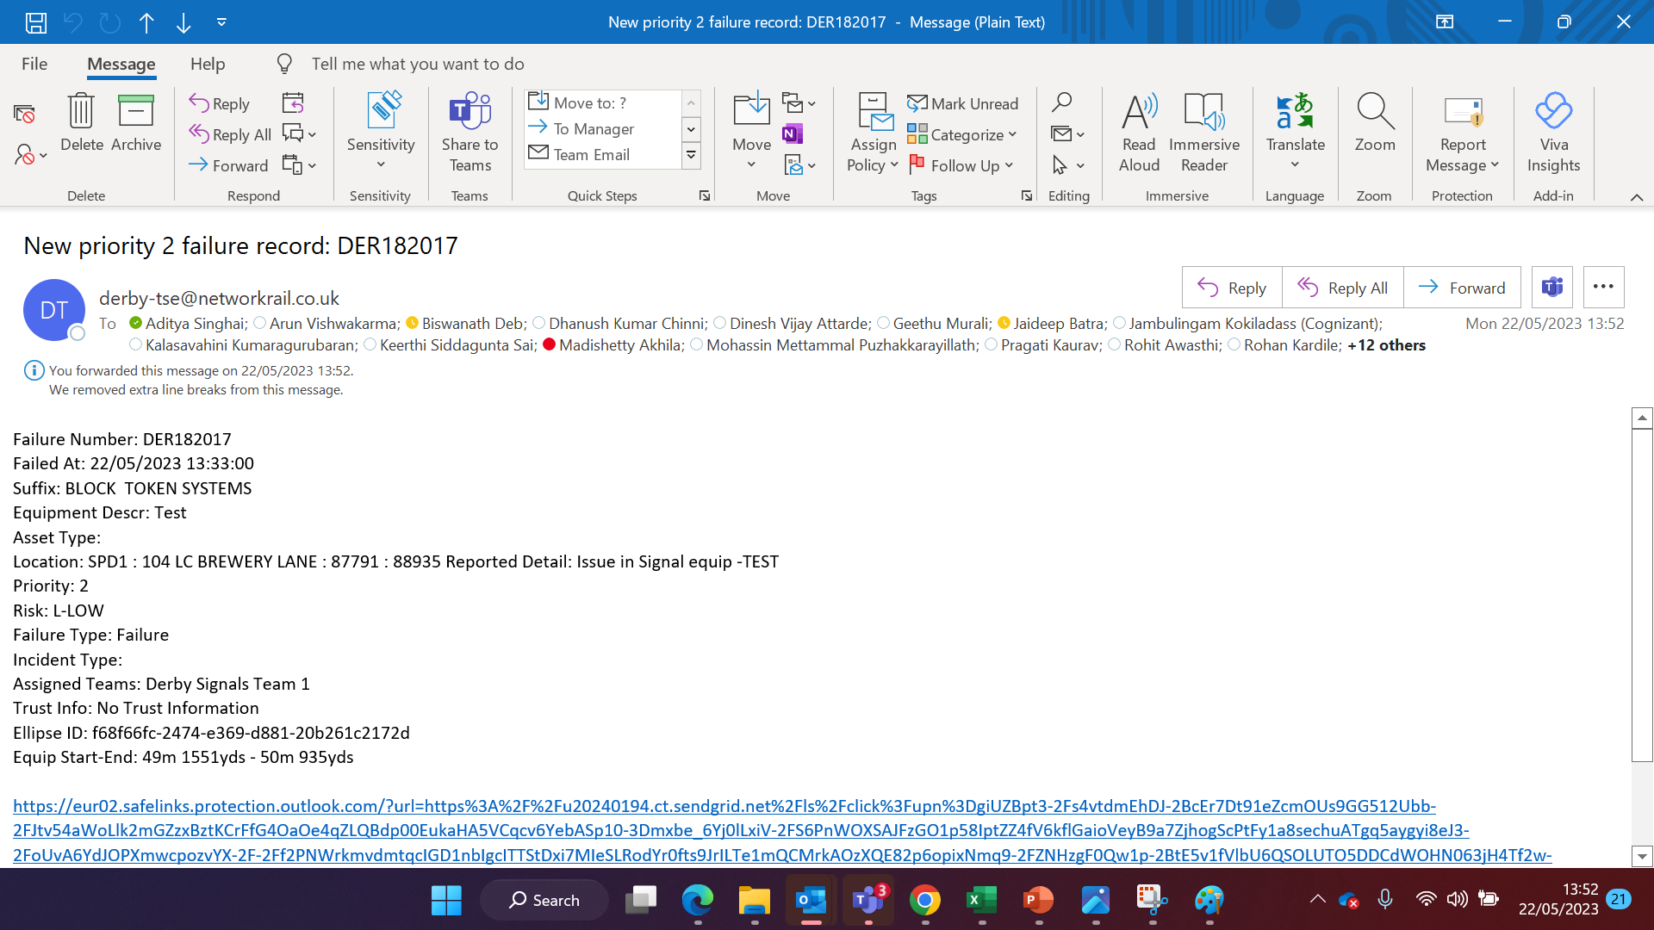
Default Email Sent to Team Assigned

Slide 20
MWM Mobile

Slide 21
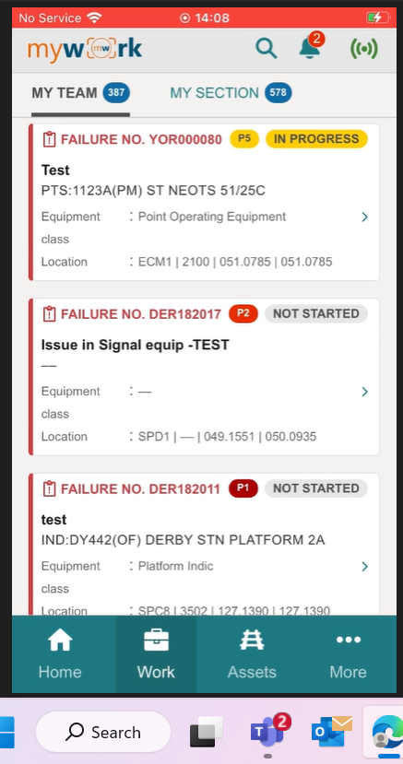
Failure Assignment received on Mobile

Slide 22
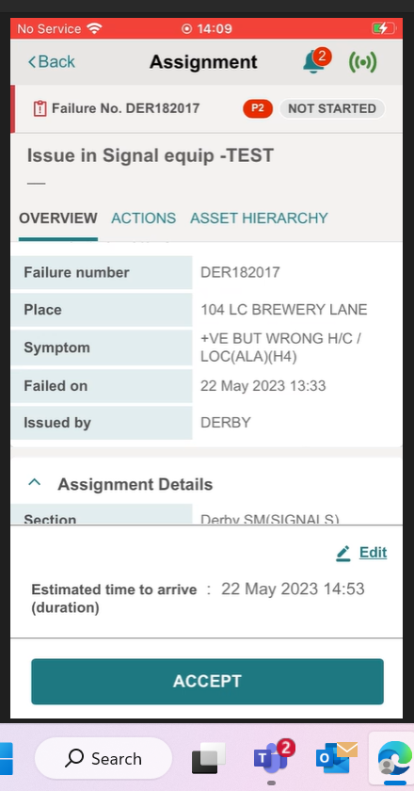
Assigned Team - View Failure Overview and Accept Failure Assignment on Mobile

Slide 23
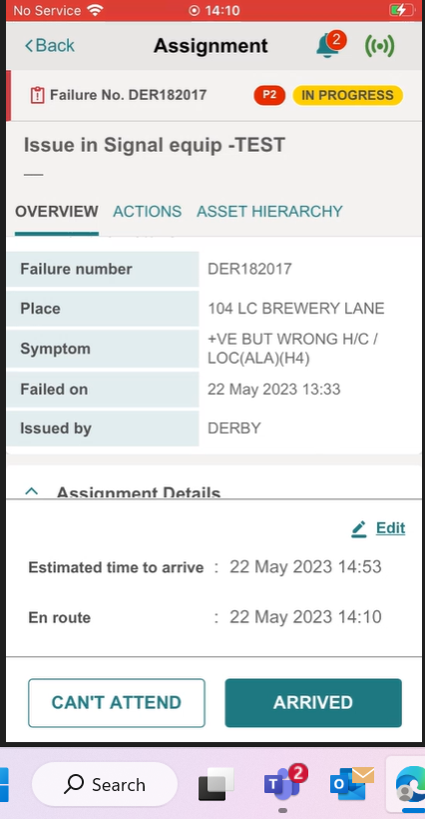
Update Arrival details

Slide 24
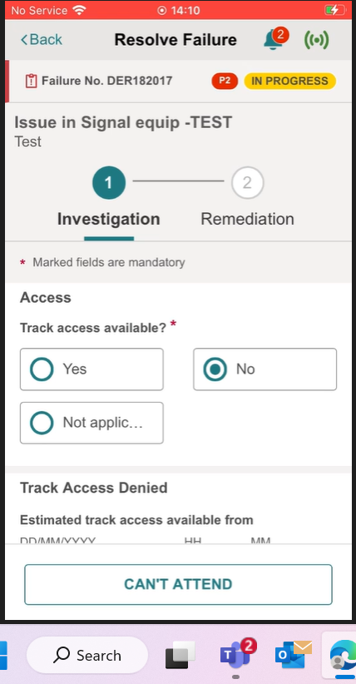
Fill Investigation Form details

Slide 25
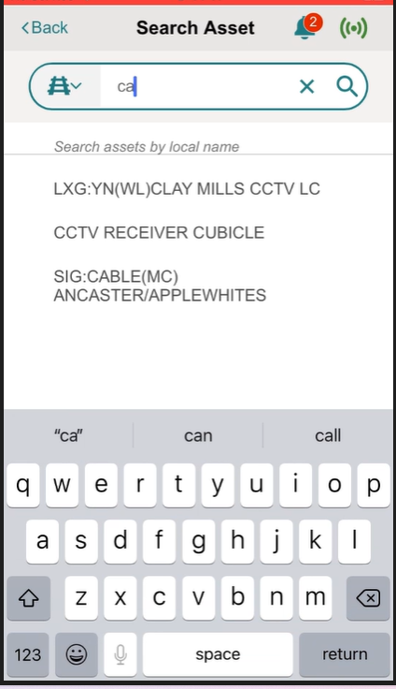
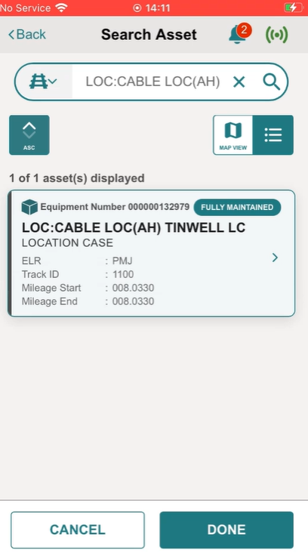
Search Asset to update correct Asset details

Slide 26
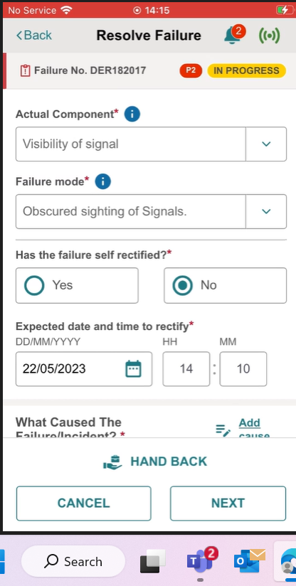
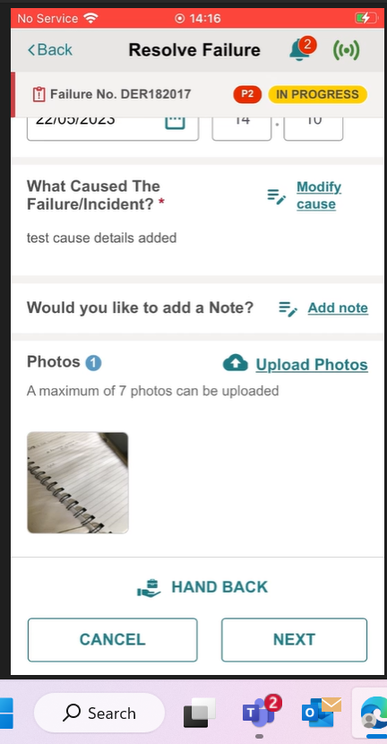
Add FEMCA data and photos

Slide 27

Complete Remediation Form details

Slide 28
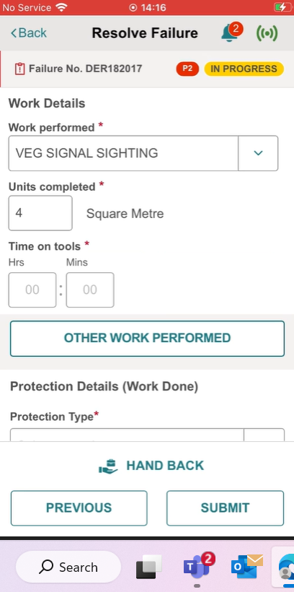
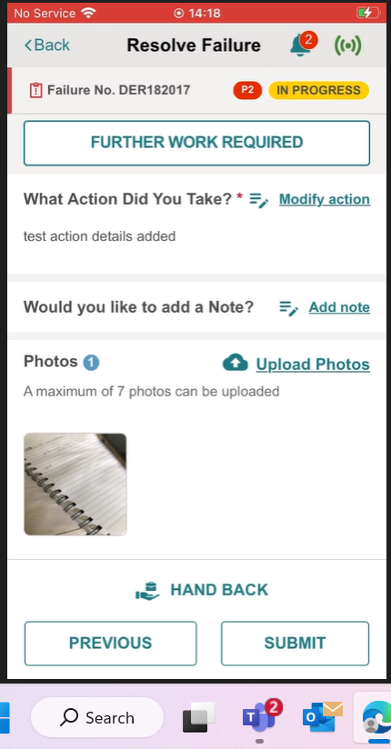
Complete Remediation Form details :Work Performed and Further Work Required

Slide 29
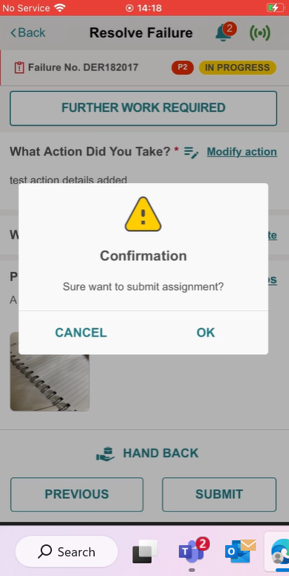
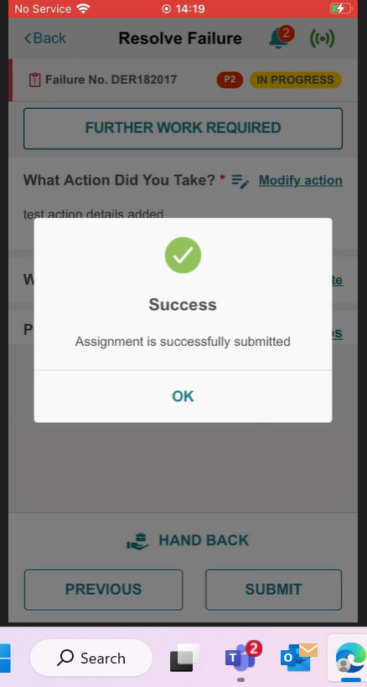
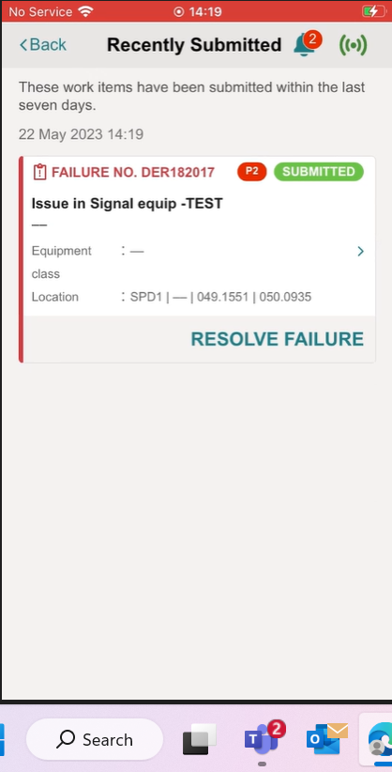
Submit Failure Assignment

Slide 30
MYIM Portal

Slide 31
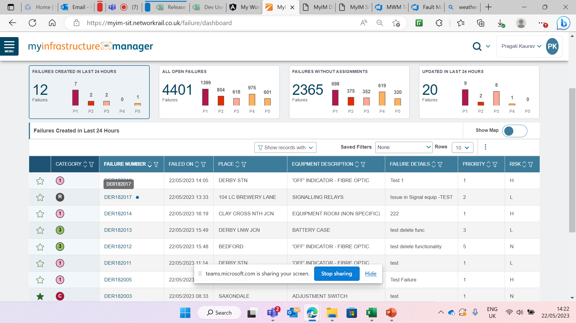
Failure ID on MYIM Portal

Slide 32
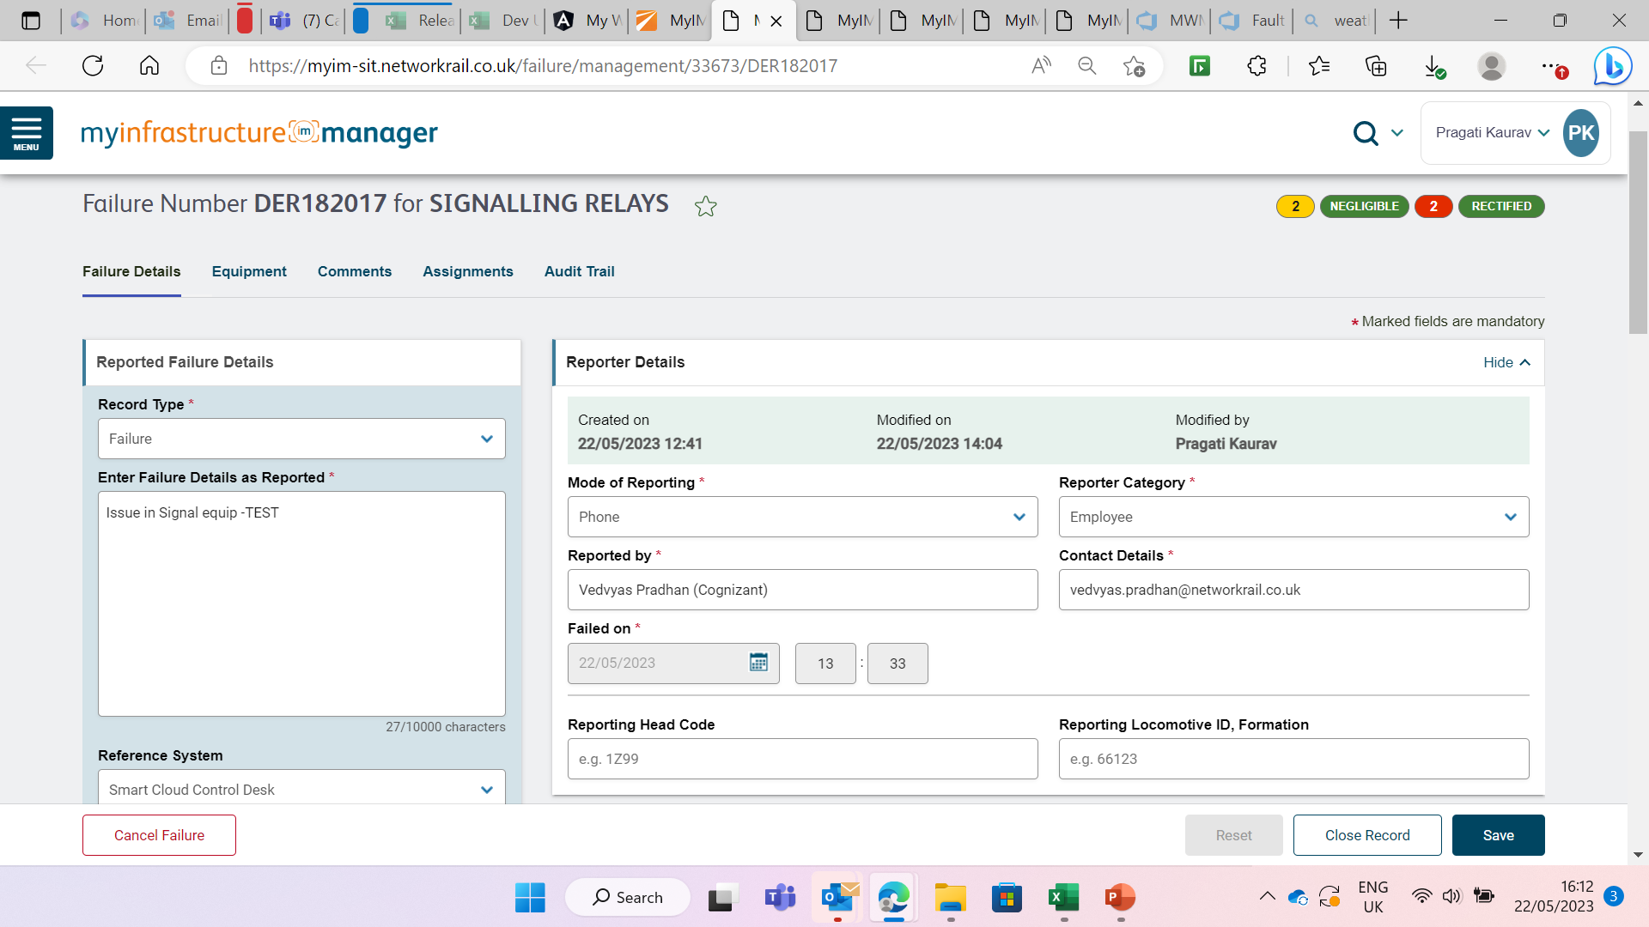
Failure details on MYIM Portal

Slide 33
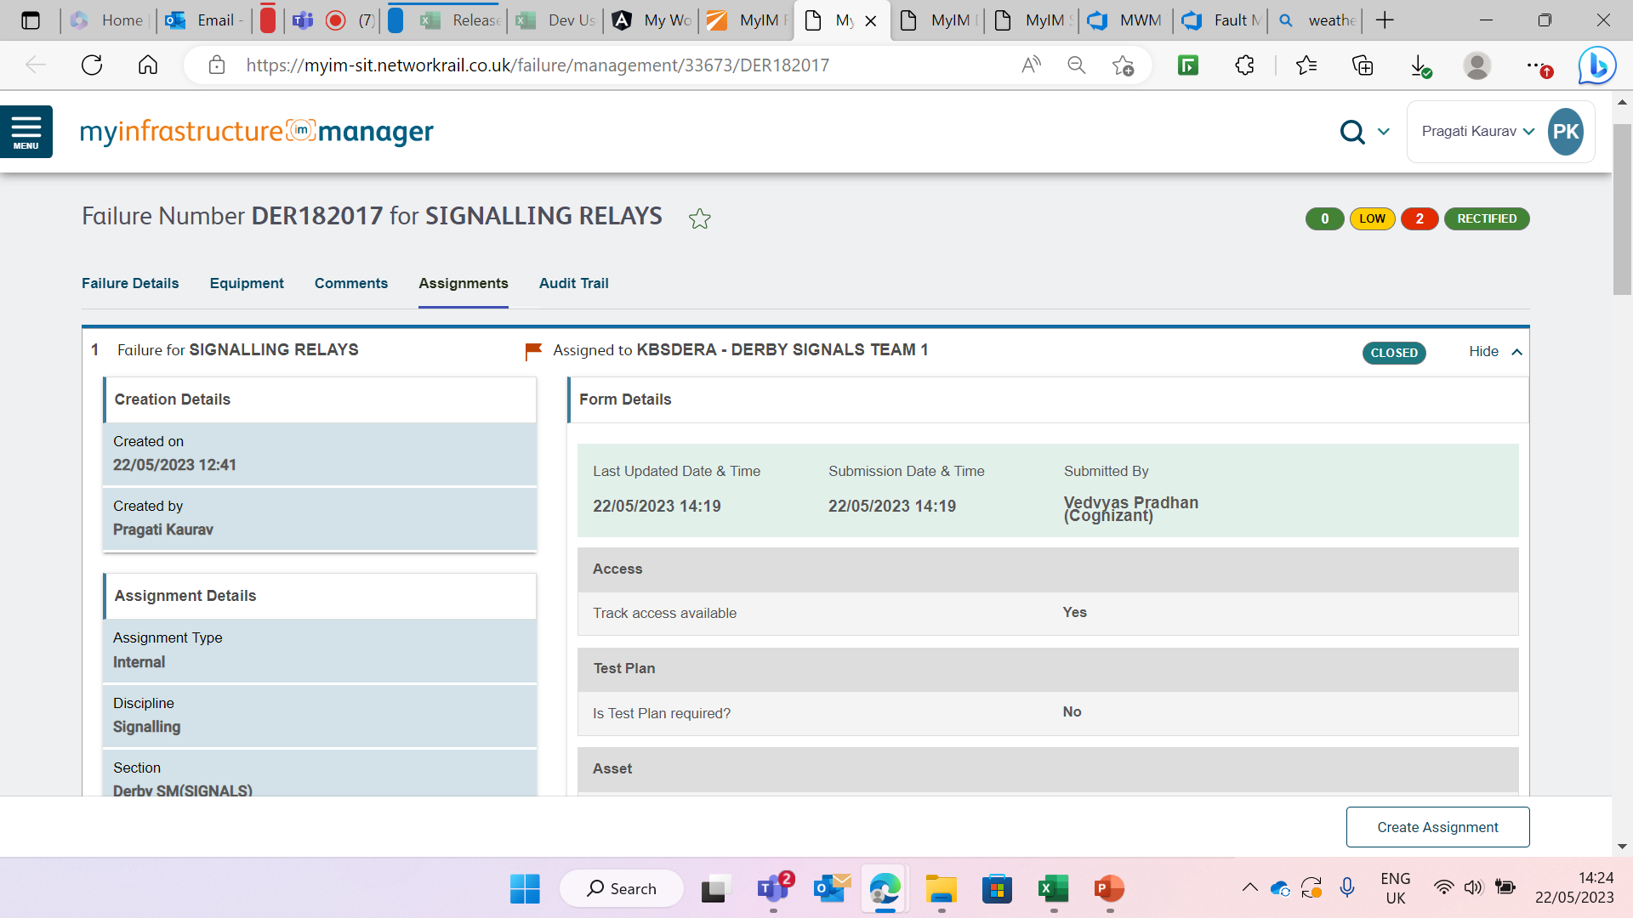
Submitted Form details visible on MYIM Portal

Slide 34
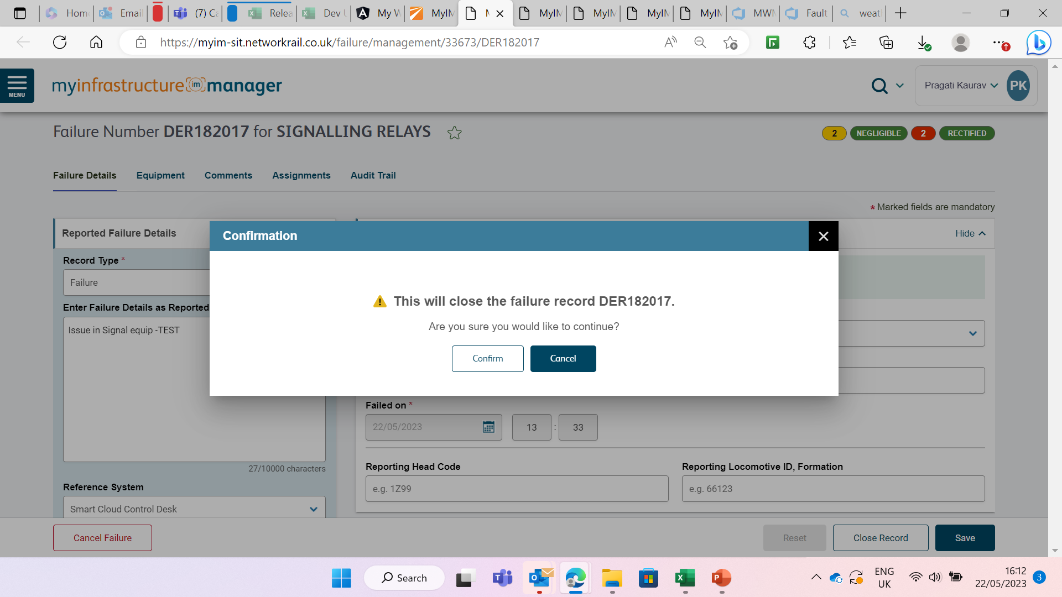
Close Failure on MYIM Portal

Slide 35
MWM Portal

Slide 36
End to End flow –
Failure Creation on MYIM to Approval on MWM Portal
Call comes in and Controller Create Failure in MYIM
Controller Assigns Failure ID to a Team
Failure ID Available On MyWork App
Review Failure On App
Close Failure on MyWork App
Review Failure Closure on MyWork Portal
Approve Failure Form on MyWork Manager
Failure Form moved to Processed State and Submitted in Ellipse

Slide 37
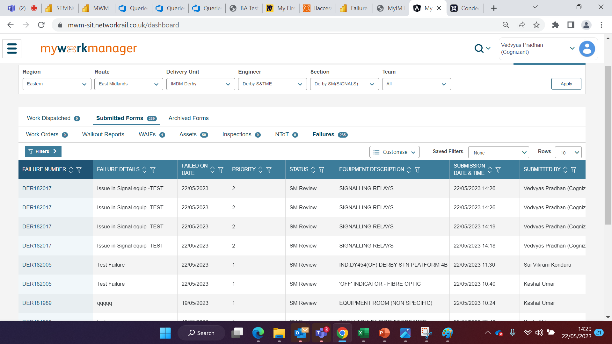
Failure form visible in MWM Portal –List view

Slide 38
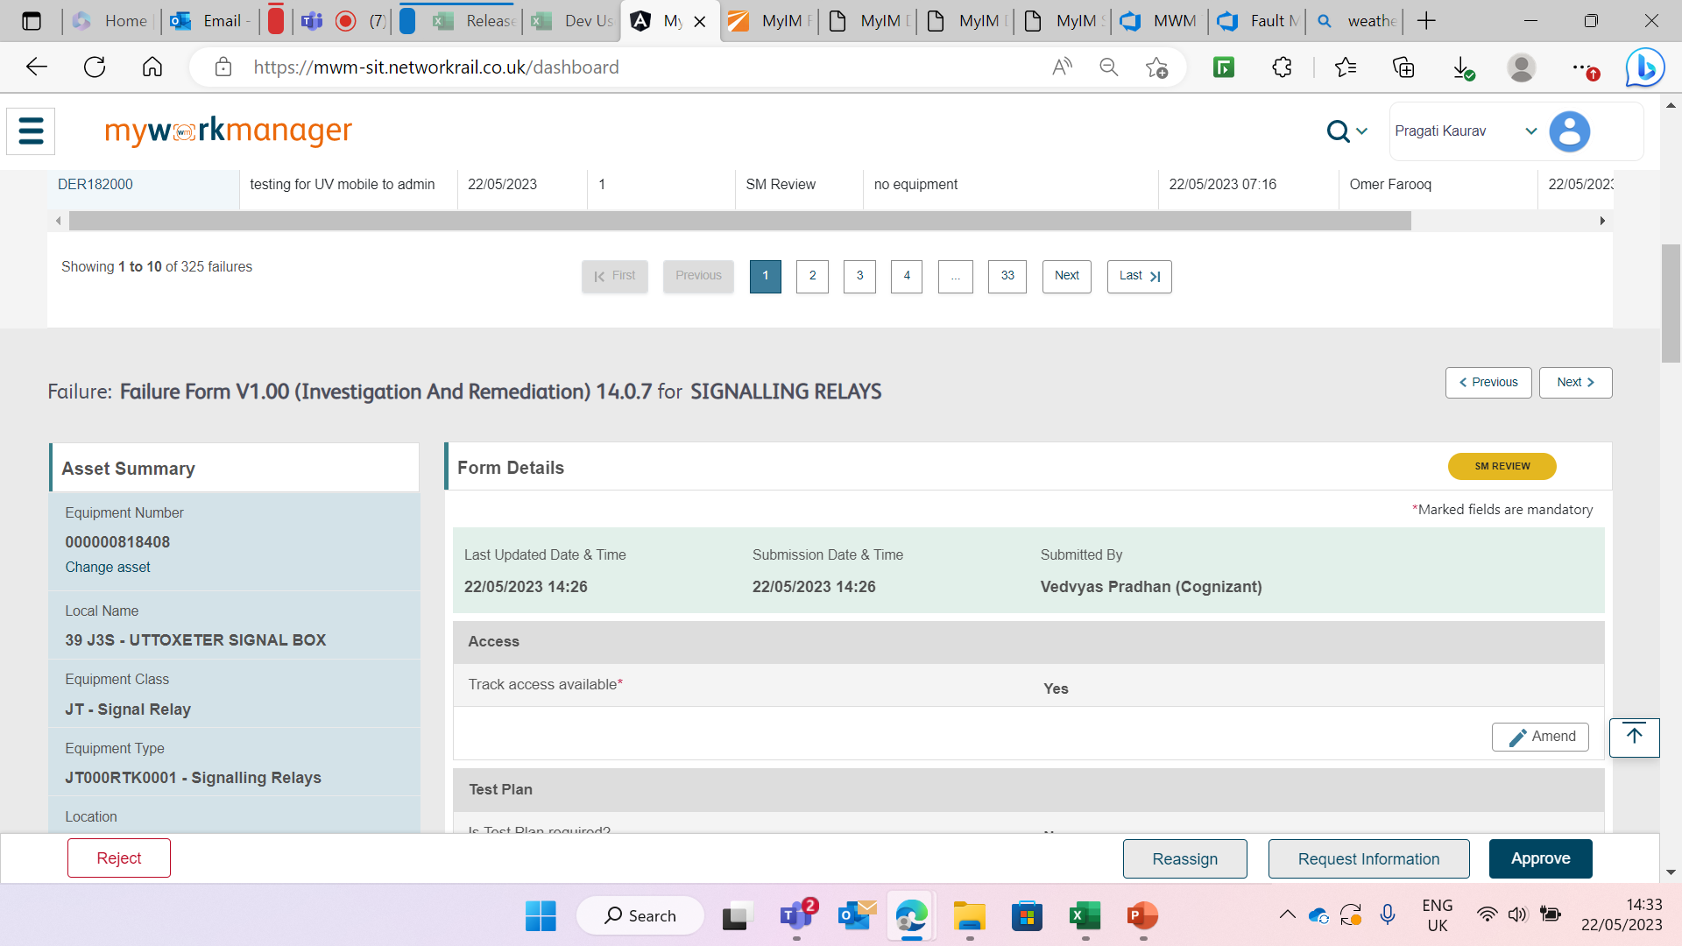
Failure form visible in MWM Portal – Form Details view

Slide 39
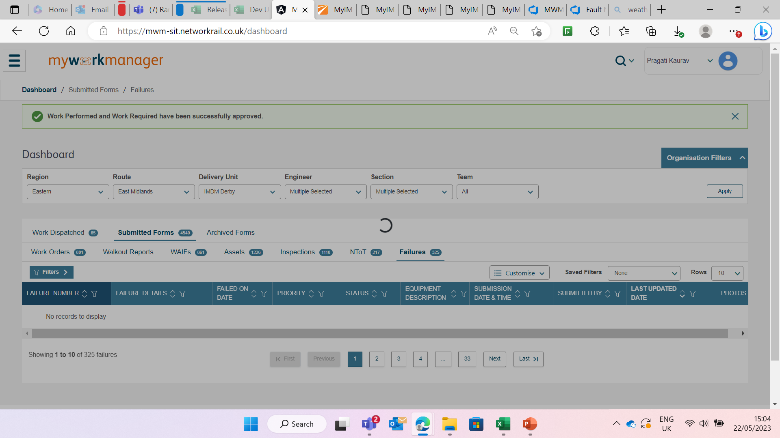
Failure form visible in MWM Portal – Approved by SM

Slide 40
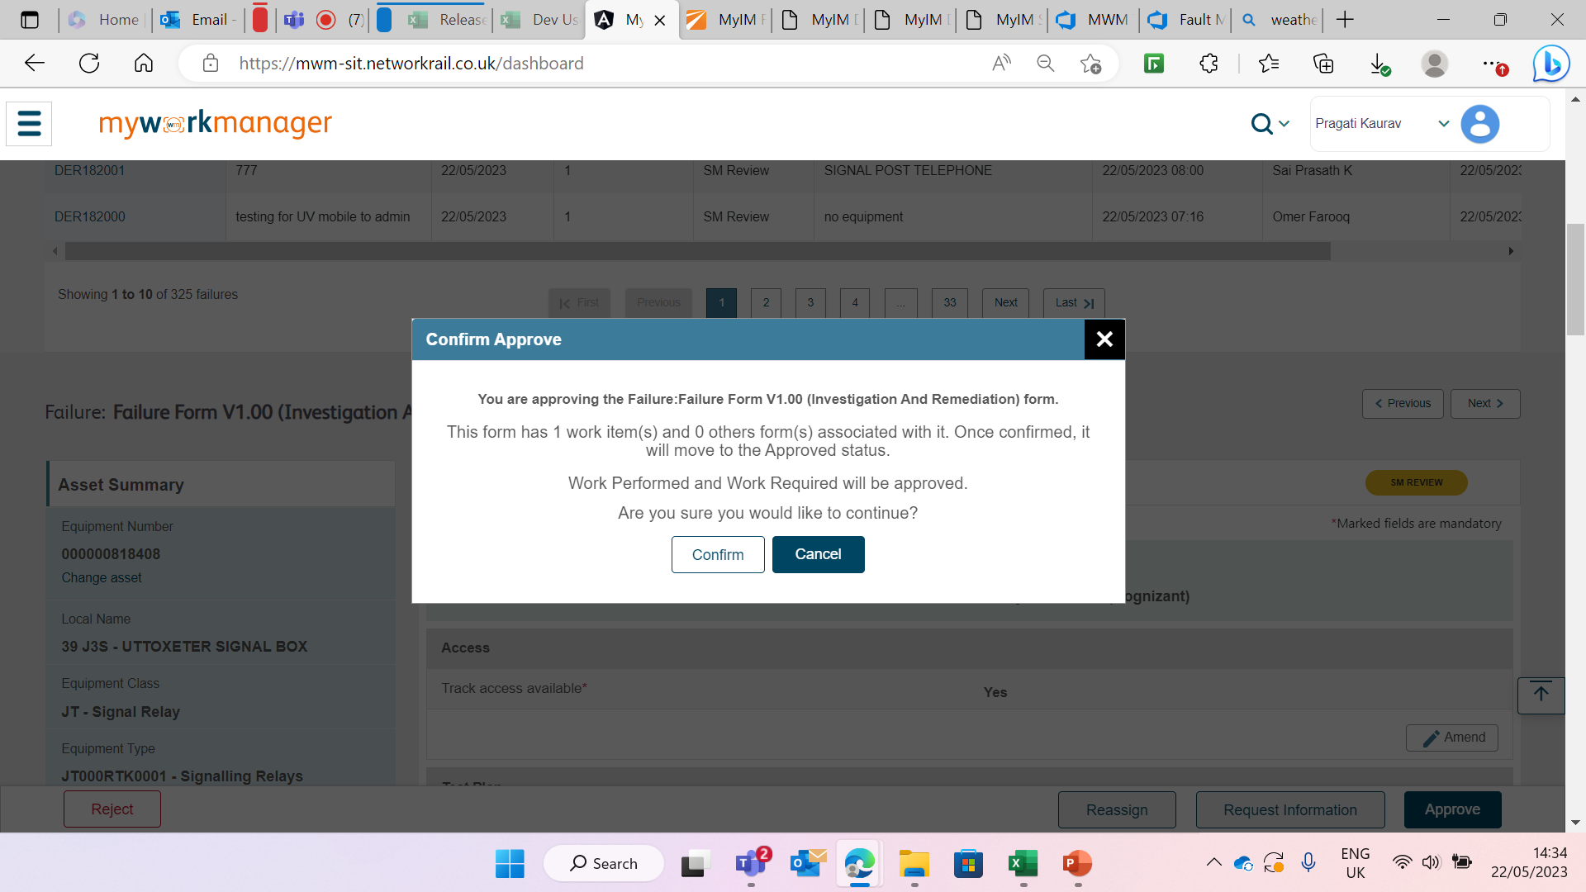
Failure form visible in MWM Portal – Confirmation Pop up

Slide 41
End to End flow –
SINCS Creation on SINCS Approval (Only for Signalling and Telecom)
Controller reviews Failure form details submitted by Field user
Controller Creates SINCS File in Failure Dashboard
SINCS Engineer prepare SINCS File in SINCS Dashboard and Assign to Approved
SINCS Approver Signs off / Send back for updation

Slide 42
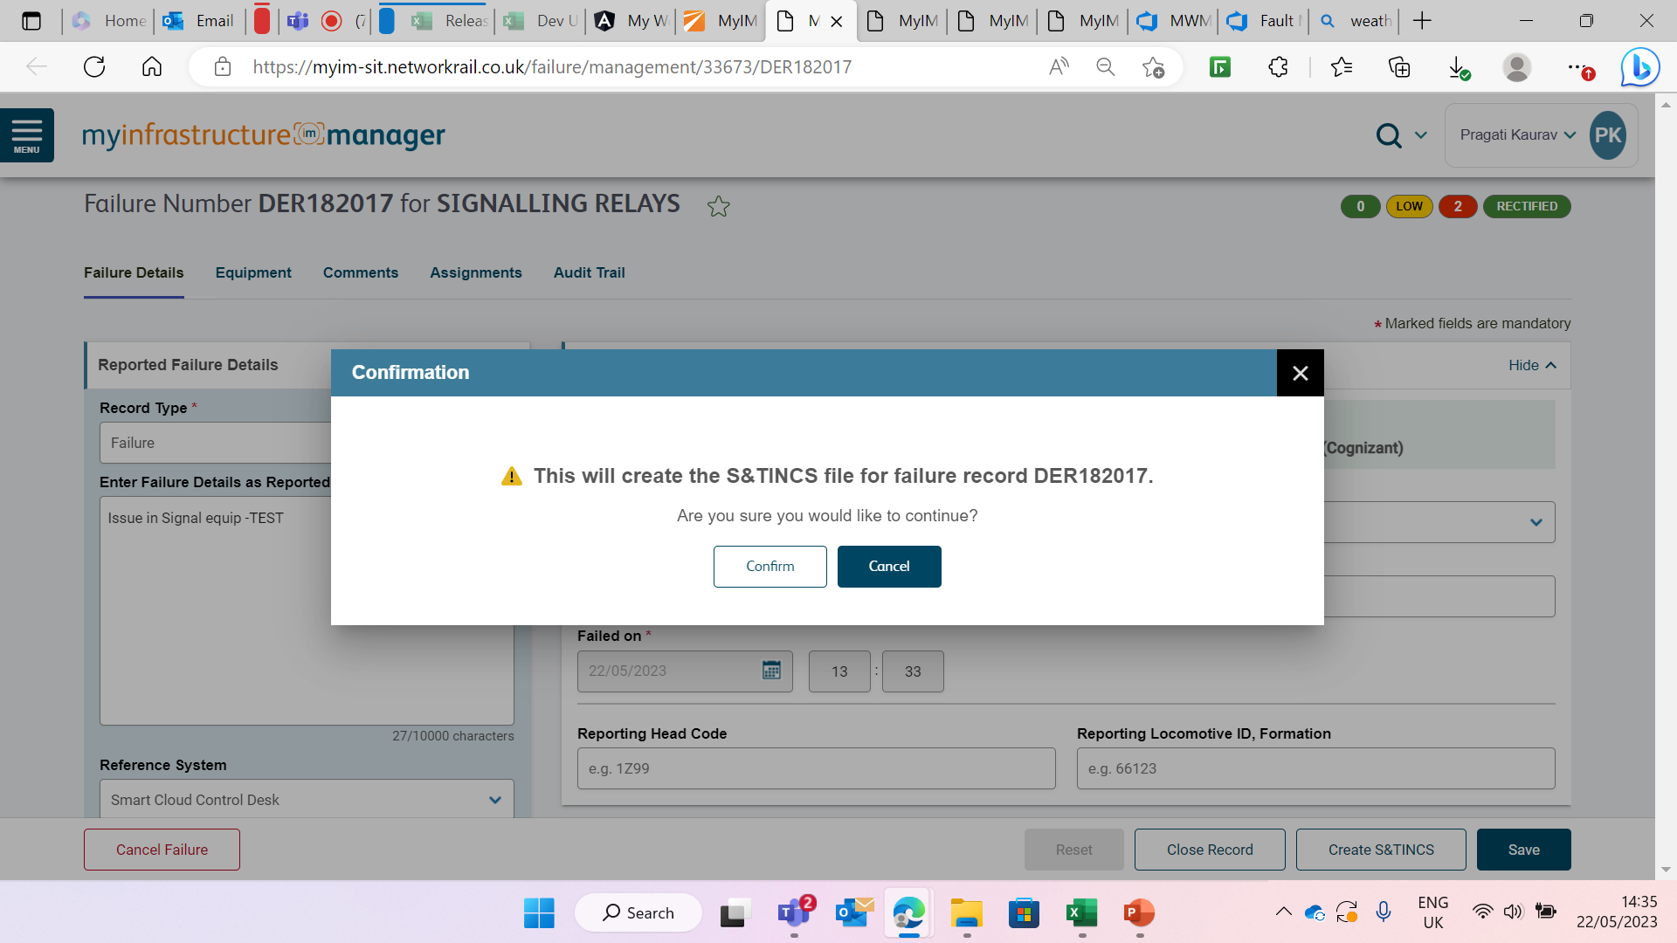
Controller creates SINCS file

Slide 43
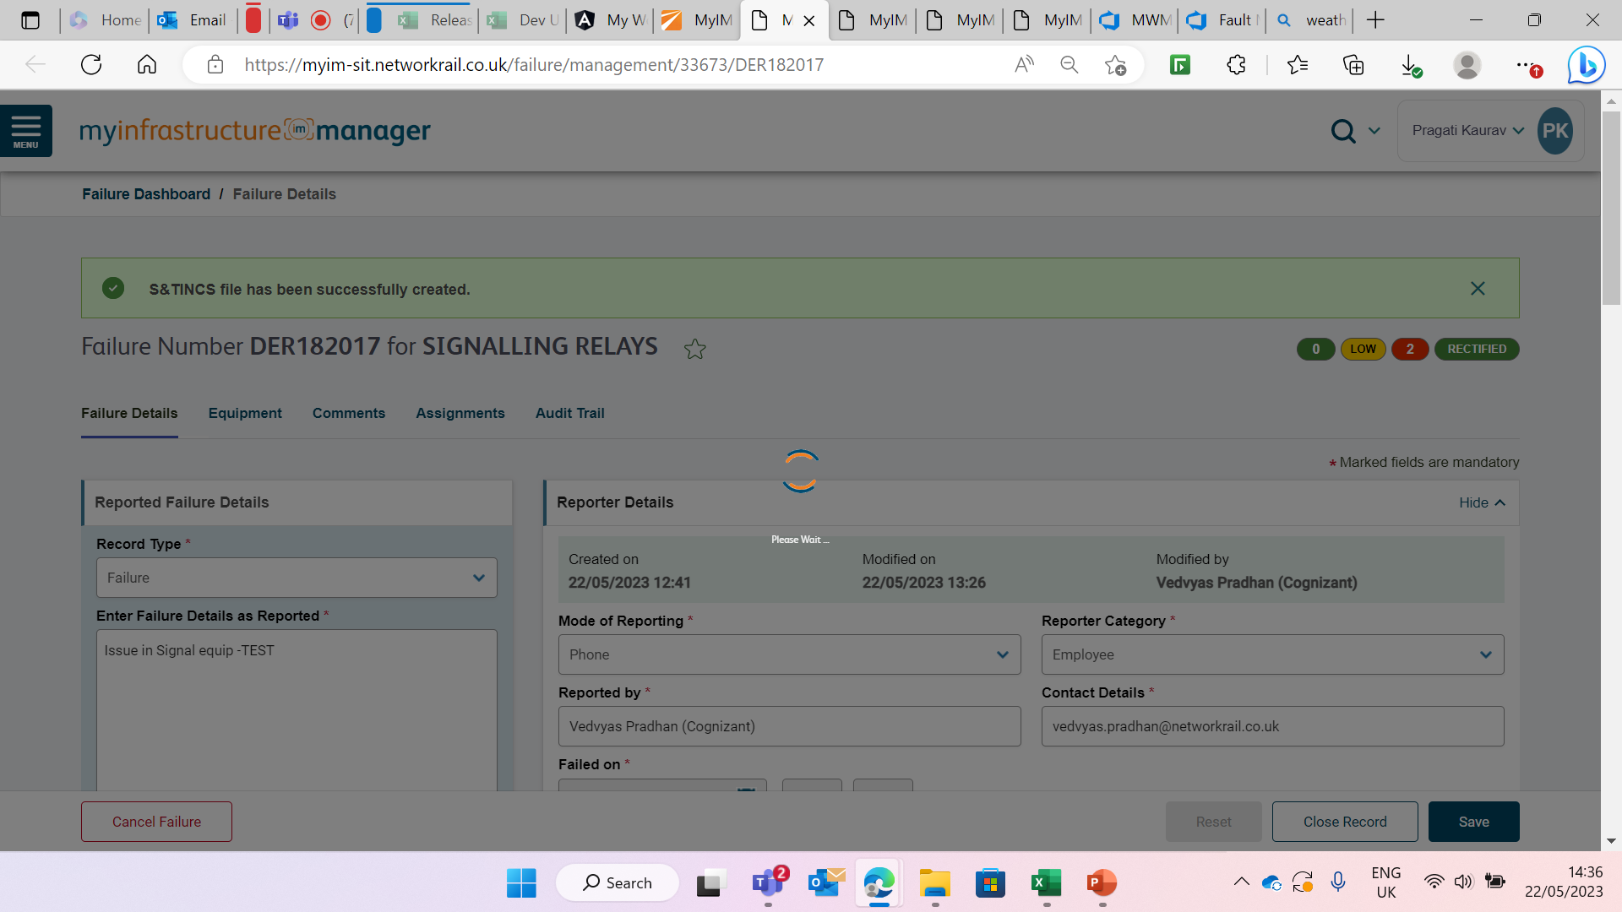
Success message is shown for SINCS creation

Slide 44
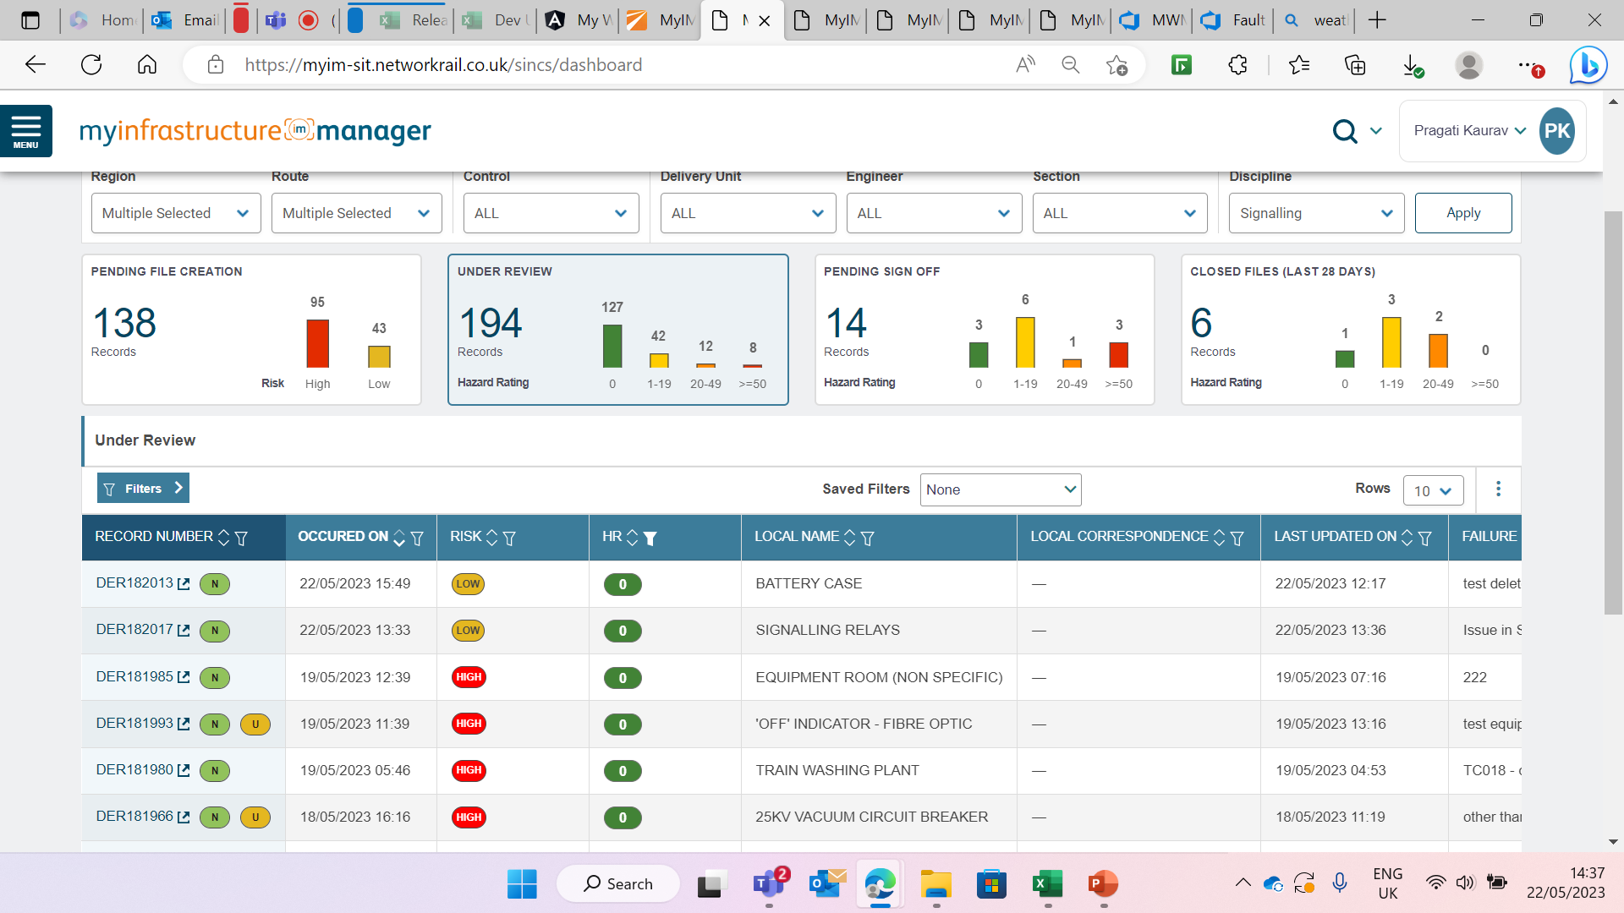
SINCS Dashboard – SINCS Engineer can view file in Under Review Widget

Slide 45
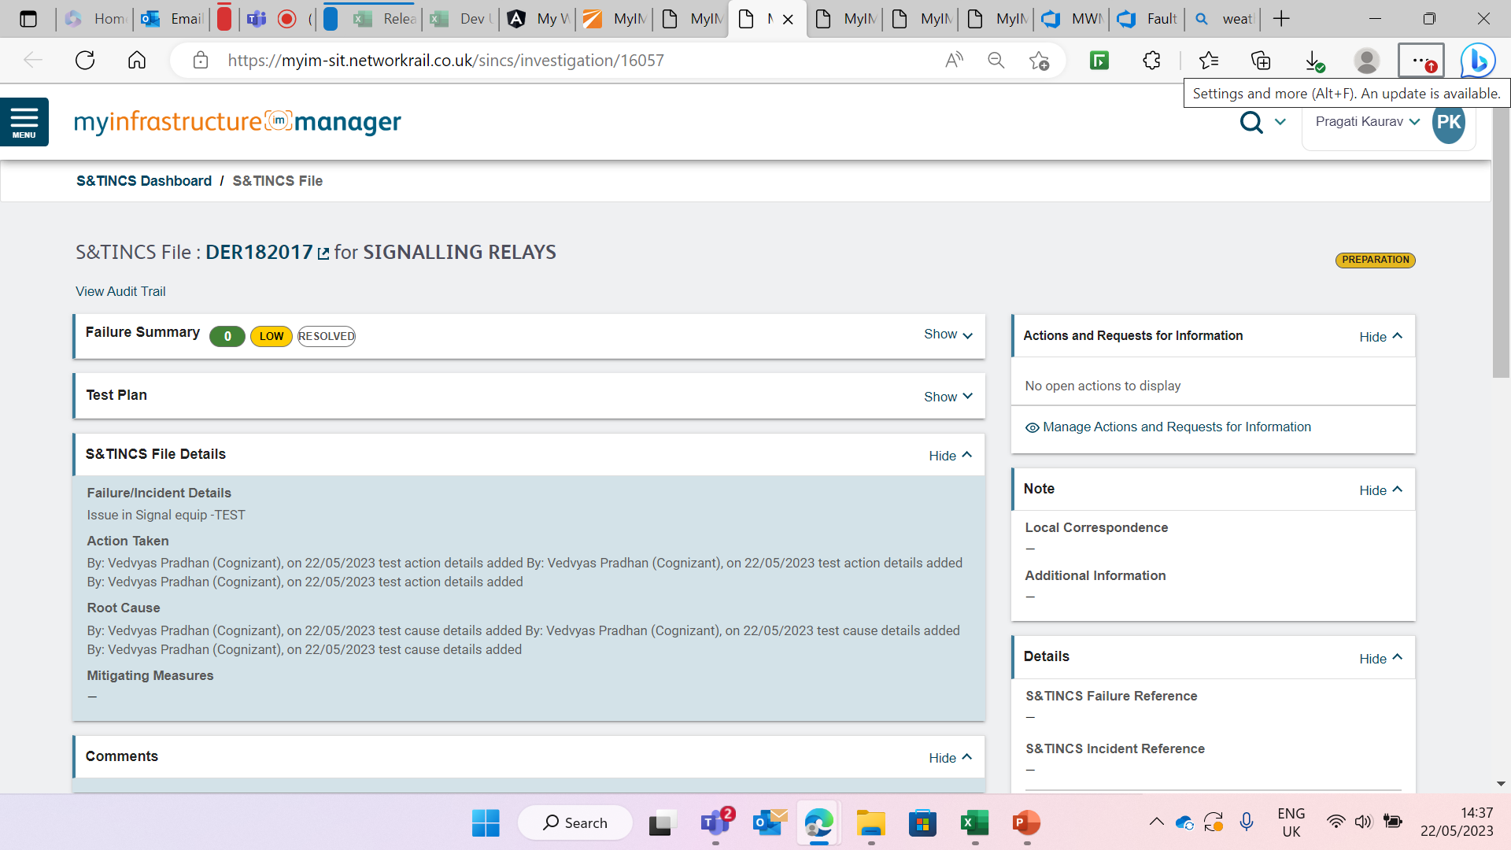
SINCS Dashboard – SINCS Engineer view details of SINCS file

Slide 46
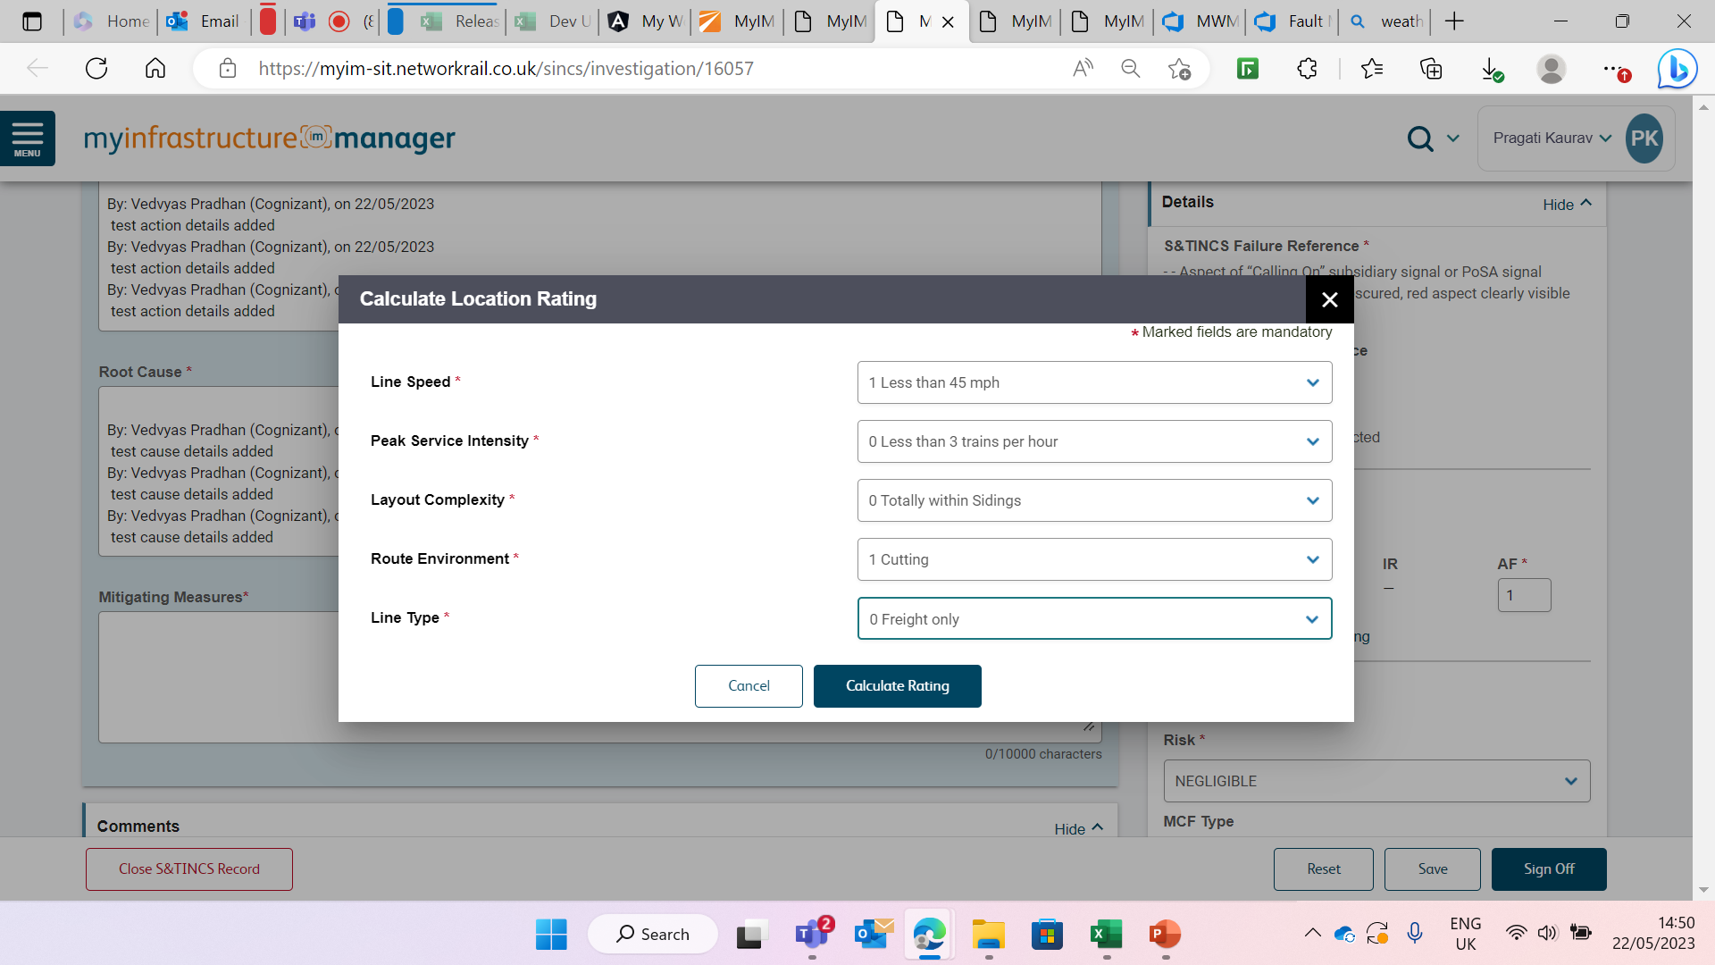
Calculate Location rating

Slide 47
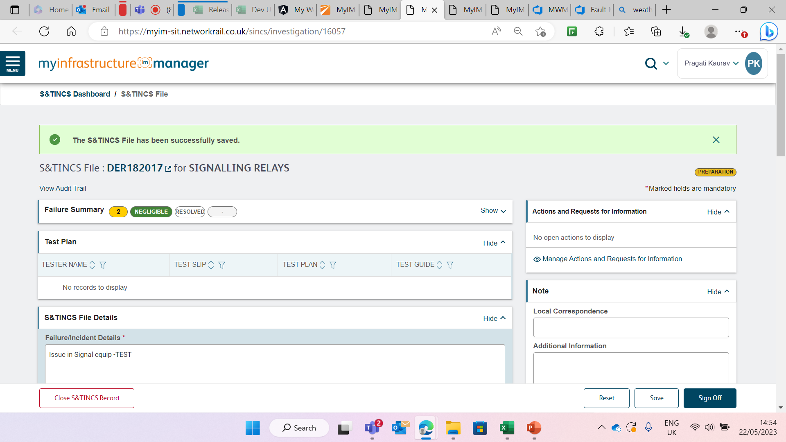
Save and Assign to an Approver

Slide 48
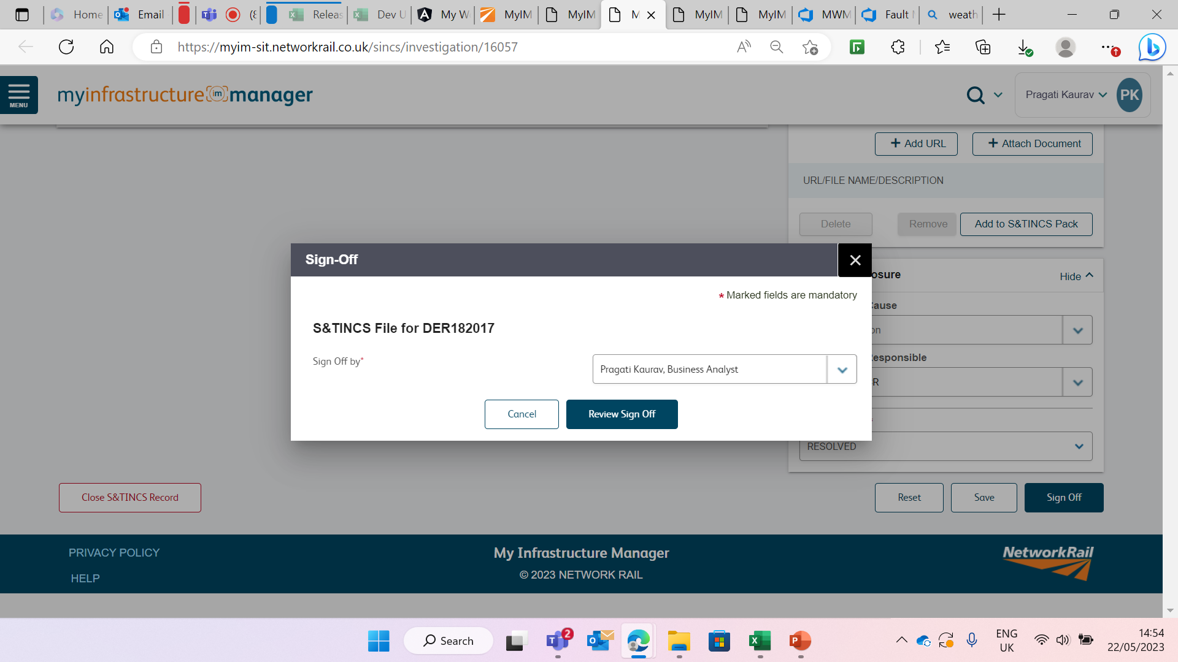
Assign to an Approver

Slide 49
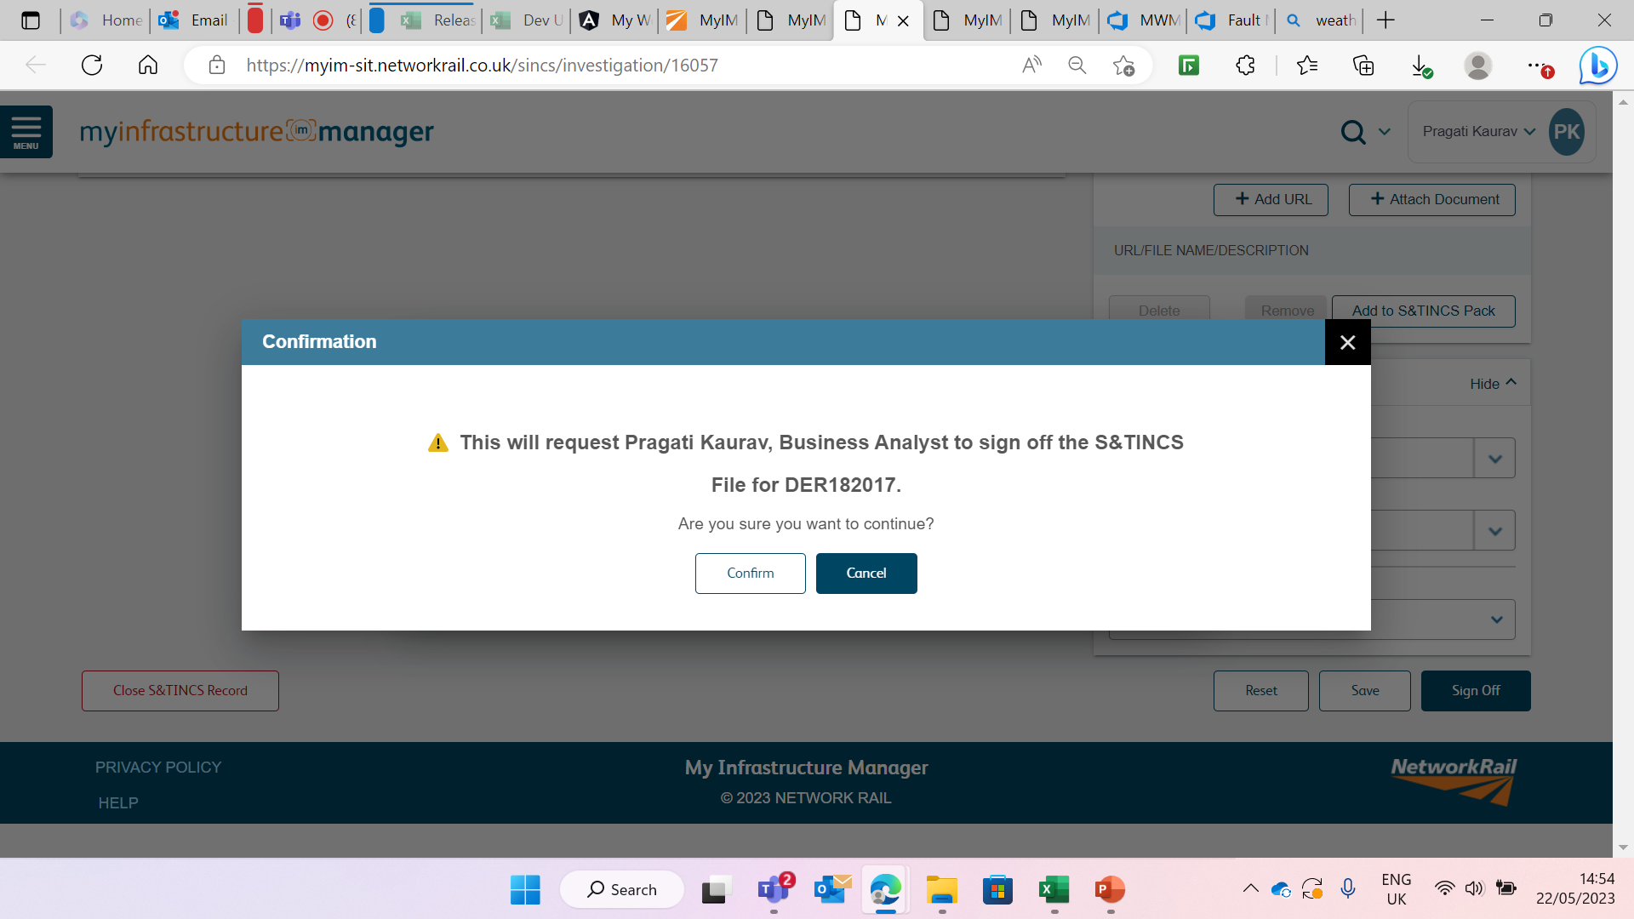
Confirmation pop up message

Slide 50
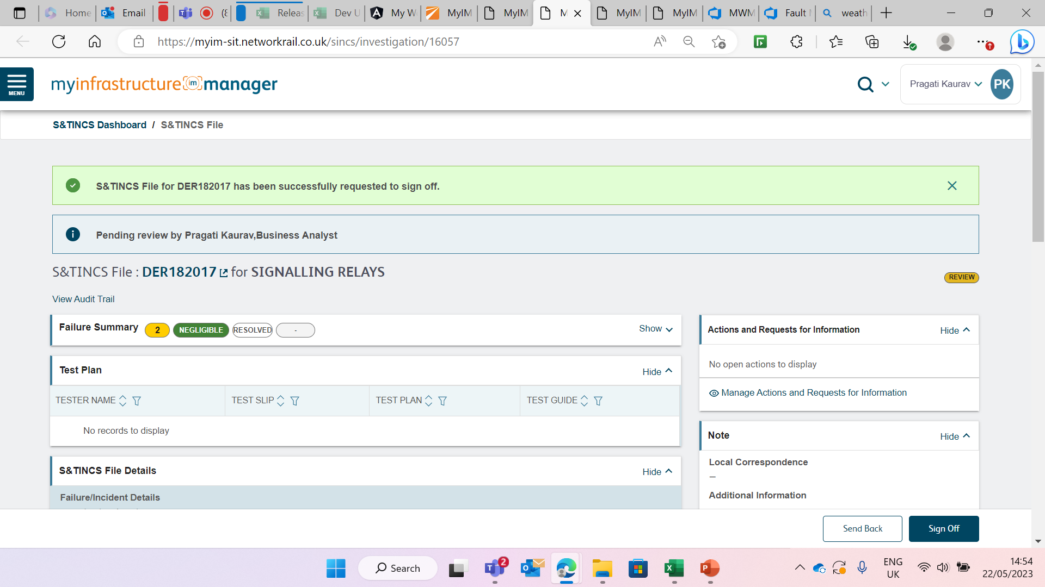
Receives Success message

Slide 51
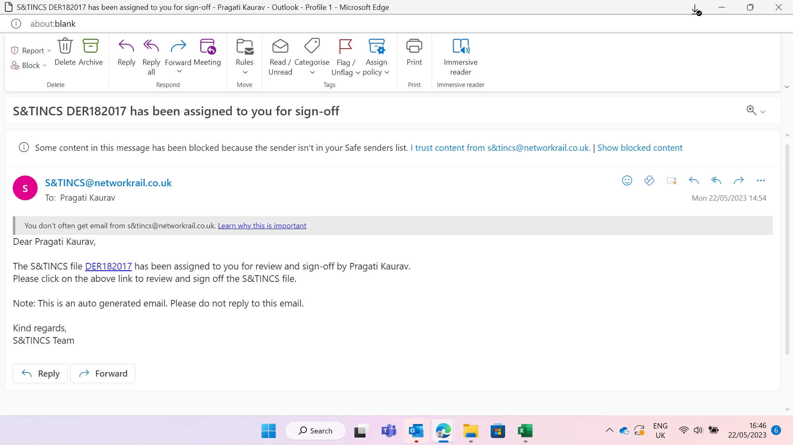
Email sent to Approver for Sign off

Slide 52
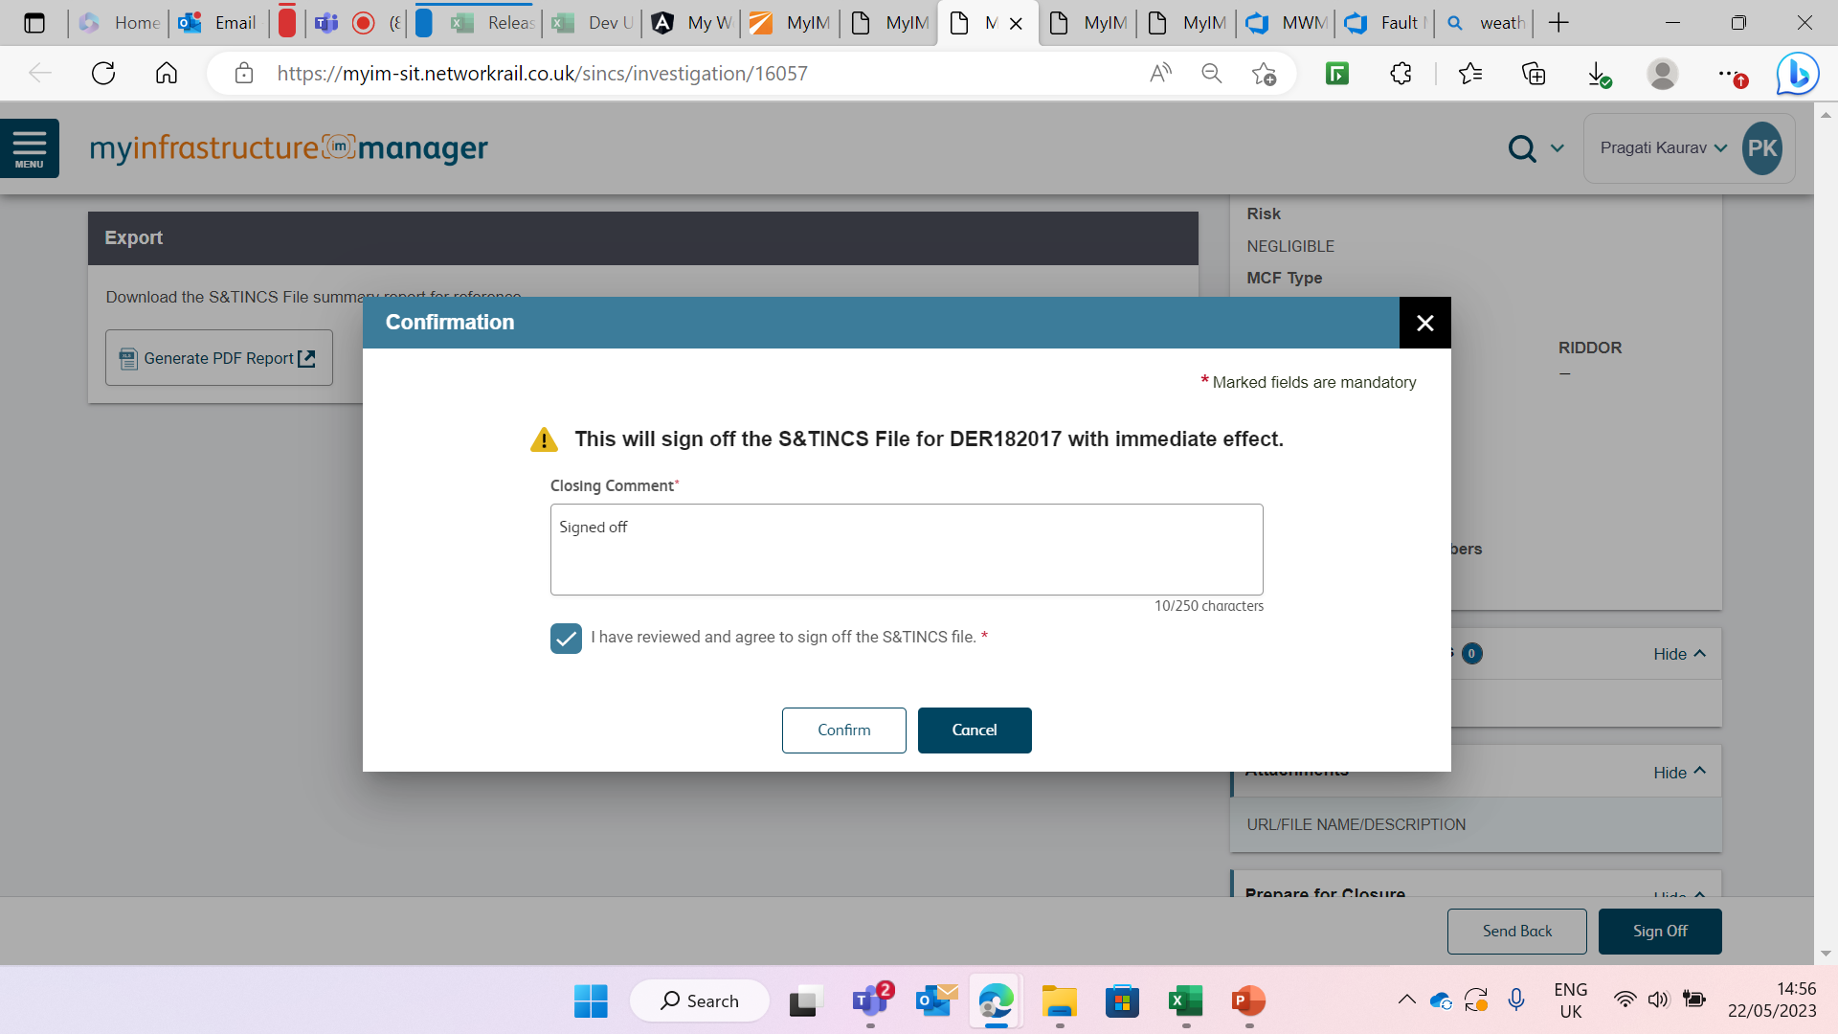
SINCS Approver reviews and add Closing Comment

Slide 53
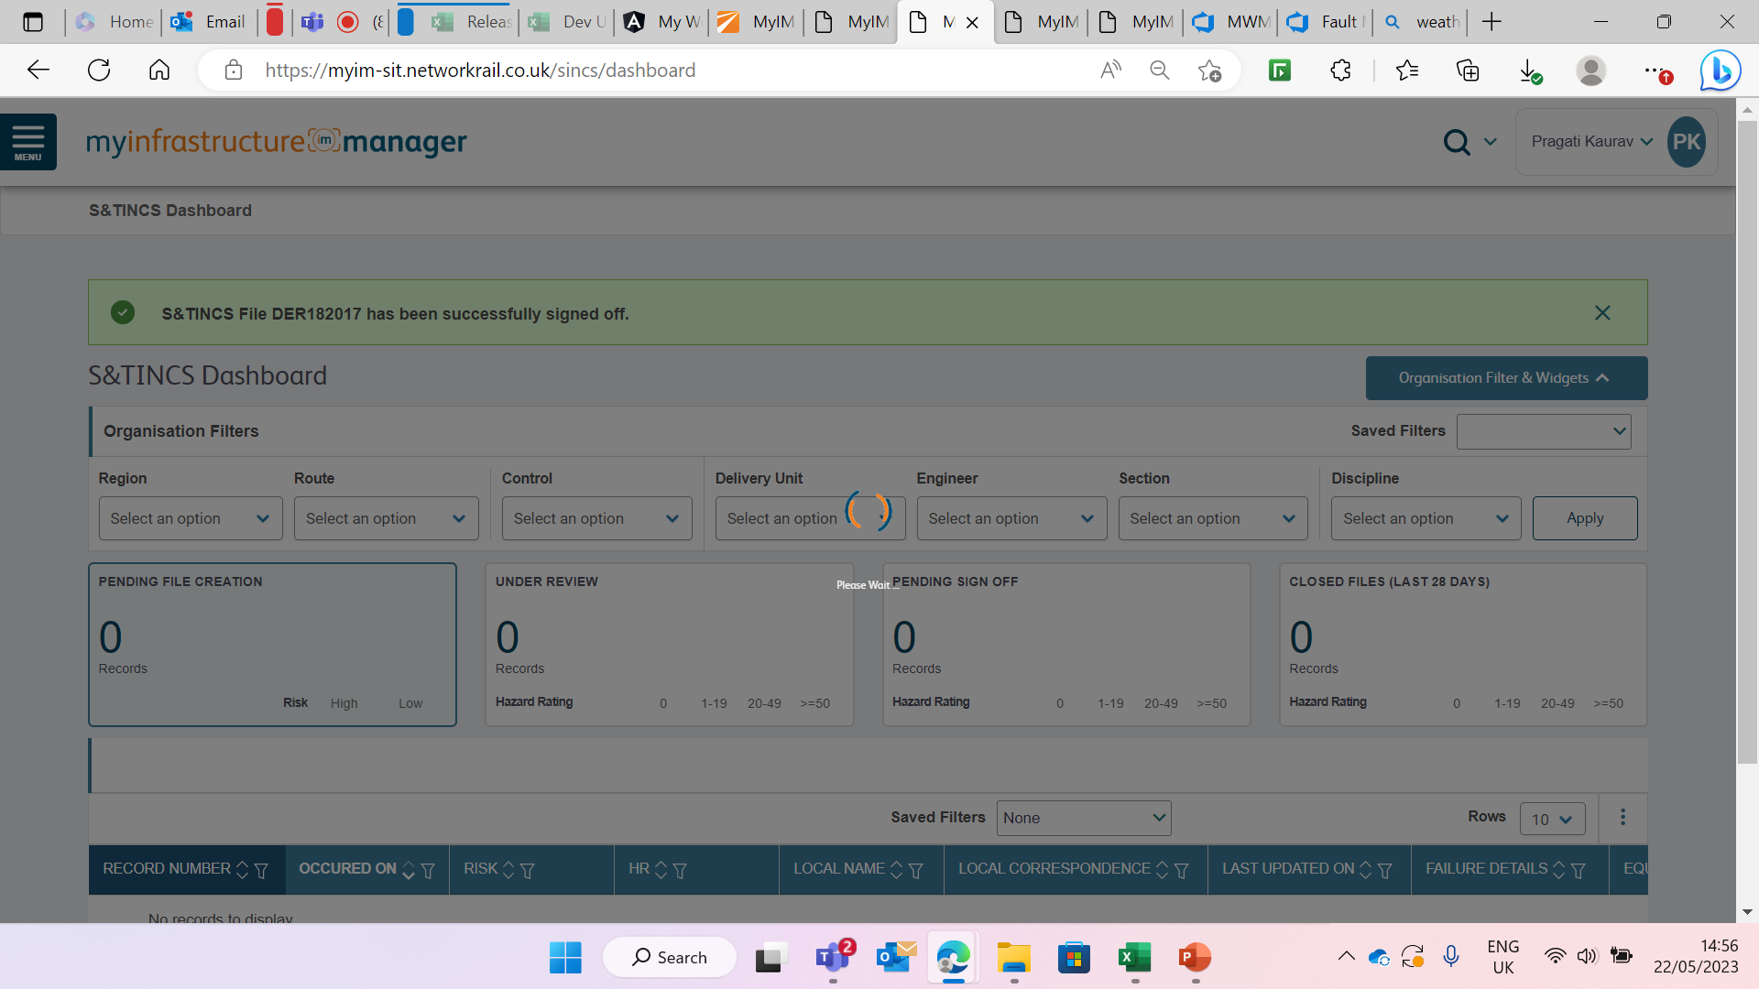
SINCS Reviewer – Receive Success Message

Slide 54
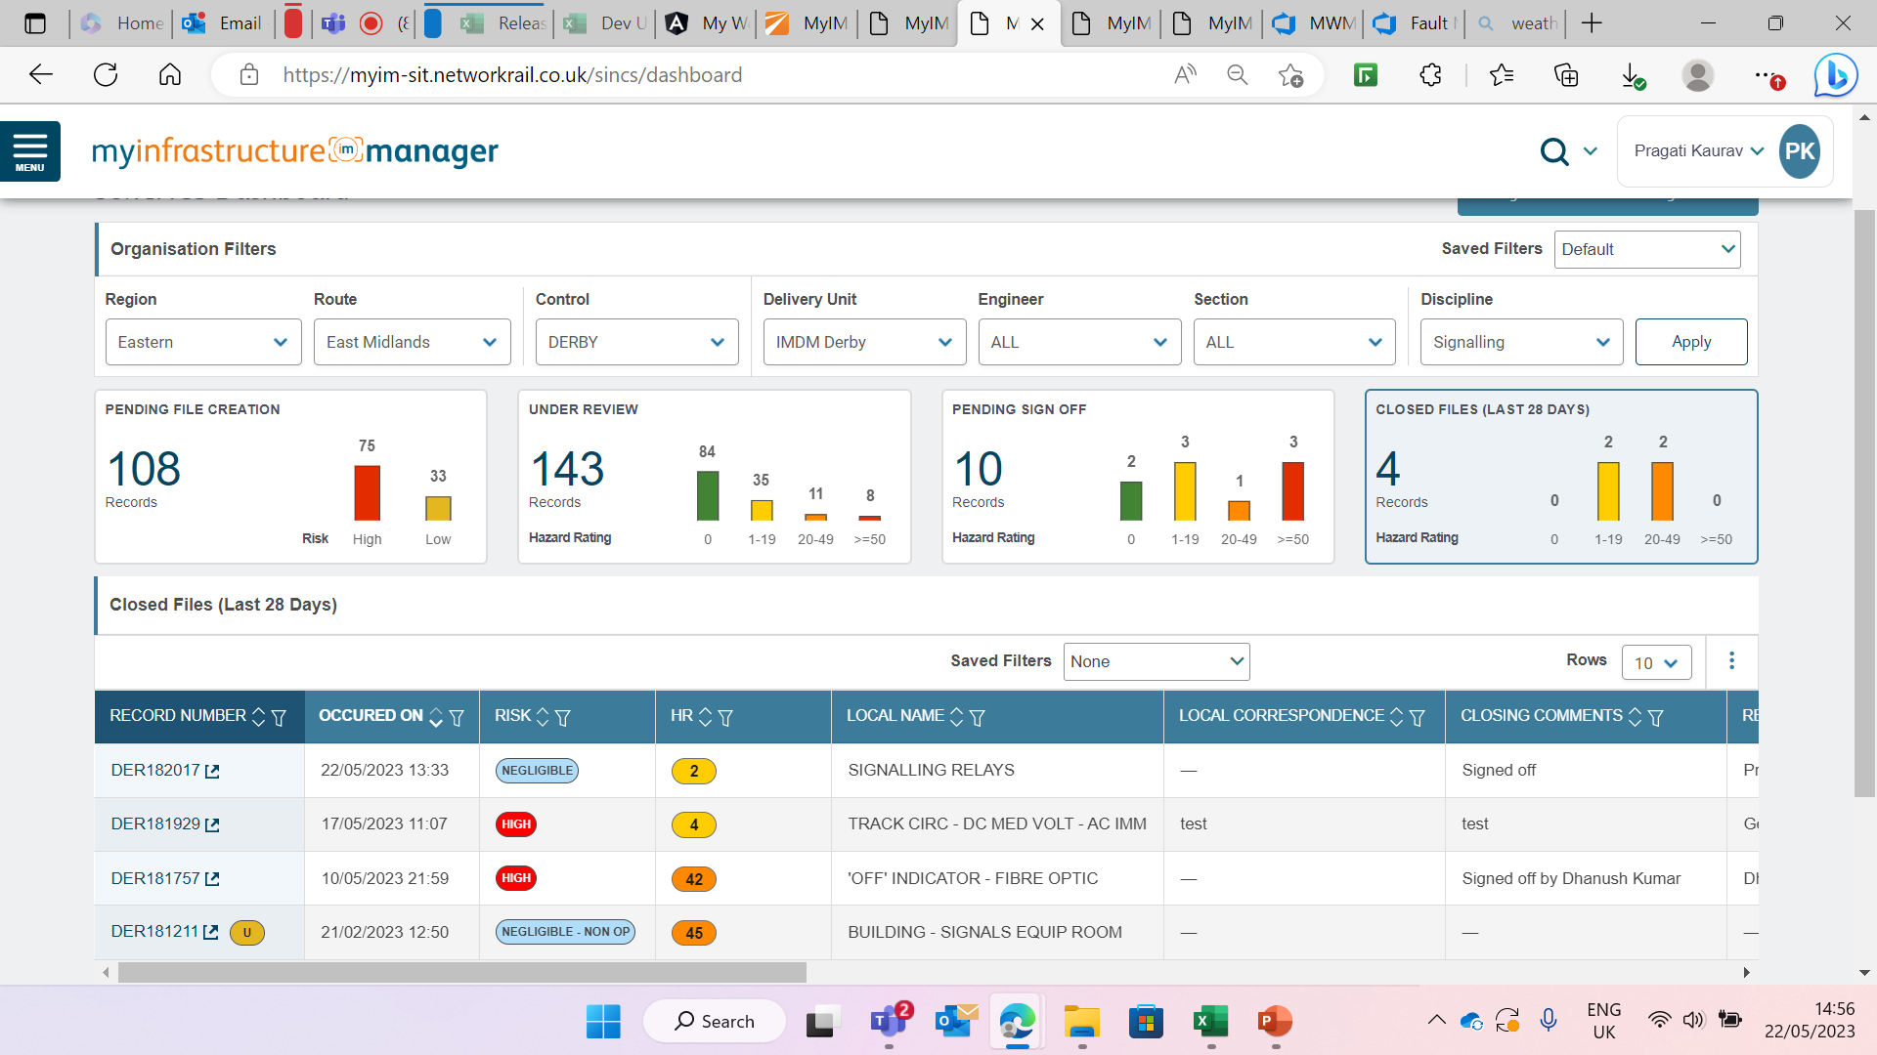
SINCS File moves to Closed File Widget

Slide 55
Application Architecture

Slide 56
Application Architecture

Slide 57
Key Components (1/4)
# | Component | Description
1 | MyIM Desktop UI (Angular/HTML/CSS) | MyIM UI will be developed using Angular CLI framework, HTML, CSS and Typescript. It is entry point for helpdesk operators to create and track fault.
2 | UI – Application Navigation Services (Controllers/Filters/Templates) | UI based on Controller and Templates in Angular. This composing HTML templates with Angular mark-up, component classes to manage those templates#, adding logic in services, and boxing components and services in modules.
3 | UI – Data Access | Angular data biding module. A mechanism for co-ordinating parts of the template with parts of component. This module is response to mark-up to the template HTML to tell Angular how to connect both sides.
4 | NR Azure Active Directory | NR Azure activity directory. MyIM WebAPI authentication to allow access users in single sign on to use application AAD groups
5 | MyIM API Gateway Management with Web Application Firewall(WAF) | It is a MyIM web traffic load balancer that enables you to manage traffic to your web/mobile applications from internet. It has built-in support for Web Application Firewall (WAF) to prevent the common security attacks. It securely exposes content of application from App Service and API Management’s developer and API portal. App Gateway helps to follow the well-established cloud security pattern
6 | MyIM API Management | MyIM API Management. It is middle layer to interact with all API services
7 | Radis Cache | Azure Cache for Radis provides an in-memory data store based on the Radis software. It is used to store the sessions of the users, and dashboard data.
8 | Azure Application insights | It constantly monitors the implementation components (Azure Function or a Logic App), which automatically detects any performance anomalies, and uses powerful analytics tools to help diagnose issues with the components if any.

Slide 58
Key Components (2/4)
9 | Azure Function | Azure API Function to fetch and store / fetch videos images of assets from ADLS Blobs. To communicate with and DataMart to fetch Asset Register, Inspections, GIS service, Organisational and RBAC details. To fetch and store transactional data within MyIM Application database To communicate MyIM to create Defects and Work Order details after fault is approved in the MWM Portal
10 | PSS | This is an existing PSS (on premise). It has been agreed with the Business owner NOT to re-engineer the interface from the new MyIM to PSS (on-premise), rather provide all the fault data in to a DataMart via ADS Foundation. Business owners will manage the consumption of the data for their reporting using MyIM DataMart.
11 | Application Database | It is internal MyIM Database which holds the transactional data and MyIM admin and roles details. Assets previous Faults and SINCS history can also be stored in this Database. Fault information to downstream operational systems will be provided from this Database upon request through API calls. Azure Foundation holds data in the same structure /granularity as the sources like Ellipse, ADS AND GIS. The data will be curated and pushed into DataMart which can be accessed by many other dependent applications like MyIM.
12 | DataMart | DataMart will store reference data of EAM, Organisation and GIS data which can be used as reference for other applications. MyIM is one of the application which uses these data to create the faults. The MyIM DM is a separate schema in Azure DM. The strategic DM for failures was not available and need to deal with all the required data migration. It will be used to store MyIM time-series data about faults against different assets that can be retrieved along with SINCS investigation for analytical purposes

Slide 59
Key Components (3/4)
13 | Azure Foundation DB | This is used to obtain the organisational data
14 | Azure Data Factory | Azure Data Factory It is the cloud-based ETL and data integration service. This service will be used to push fault transactional data from MyIM application database to Azure DataMart. This is an existing ADS on premise. It has been agreed with the Business owner NOT to re-engineer the interface from the new MyIM to ADS (on-premise), rather provide all the fault data in to a DataMart. Business owners will manage the consumption of the data for their reporting
15 | Ellipse (EAM) | Existing EAM. Ellipse is updated by MWM with a work order that defines the failure on the approval of the form in MWM pportal
16 | Fault location | Utilises Postgre to define the location of failures, so they can be located on a map. All other locations have been defined by MWM and reused.
17 | Azure Monitor | Azure monitor to be used to collects monitoring data form variety of azure sources to improve the performance.

Slide 60
Key Components (4/4)
18 | Azure Policy | Azure policy in line with Platform DSD[INT 11]
19 | Express Route | Express route will be used to create private connections between Azure data centres and on-premises.
20 | Notification Hub | Notification Hub to be used to send notifications to both MyIM mobile and desktop users.
21 | SendGrid | SendGrid will be used to send emails authorised MyIM users.
2 | Azure CDN | Azure CDN (Content Delivery Network) is a that can be used caching downloaded videos, photos files that change very little over time, such as style sheets and JavaScript scripts. It i reduces the latency to provide high bandwidth content and improves the performance.
23 | Azure Firewall | MyIM will follow NR Azure Firewall rules. MyIM should be allowed to work on particular ports and inbound and outbound rules to be updated in Azure Firewall settings by platform team.
24 | Azure Logic Apps | MyIM uses Azure logic apps which helps to schedule, automate and orchestrate tasks. This will be used with Azure functions and API calls where a series of steps to be executed in order to complete a particular single task.
25 | Visual Studio | Visual studio 2019 and Visual Code is IDE for the development.
26 | Azure Dev OPS | DevOps is a set of practices that combines software development (Dev) and IT operations (Ops) several DevOps aspects came from the Agile methodology. MyIM follows the Platform DSD rules.
27 | MyIM Mobile Application | MyIM functionalities for the field activities will be developed for iOS mobile and iOS Tablet users

Slide 61
Areas of Divergence / Concerns

Slide 62
Areas of change
Description | Design as per DSD v2.9 | Current Design
Ellipse Integration | Failure record when it gets closed in MyIM will be used to trigger creation and closure of defect, work order, etc in Ellipse via Ellipse cloud APIs. In this process until the fault is closed in MyIM, Ellipse frontend users will not have the visibility of the open faults | Integration with Ellipse will be handled in MWM mobile solution. MWM Portal will create Work Orders and Updates Ellipse per the current Design. [INT35]
GIS Data | GIS data and related information (equipment and faults) shall be exposed as map services using GeoServer. The map services shall be used by MyIM application for viewing, querying and fault creation purpose within the web application | Place is planned to mastered in GIS initially. Place is now mastered in MyIM Application DB.
MyIM Mobile Solution | IOS mobile application for the field users like Faulting teams, MOMs, etc. for getting failure notifications and to perform investigation and remediation activities and provide periodic updates on the status of the failure. | MWM Mobile is separate project and the content of MWM mobile should be updated accordingly. All the scope and details of MWM mobile should move to MWM Mobile DSD [INT35]
Trust Integration | Cross referencing TRUST incidents record with Fault record in MyIM shall be achieved by integrating to EMS Hub where, TRUST DA messages are published. MyIM will build integration to EMS Hub to subscribe for applicable messages on a real-time. The TRUST DA messages will be stored in Azure Foundation to enable Route Controllers to cross reference TRUST ID with Failure Number more accurately so as to overcome the current data quality problems due to manually typing rather than search and pick from the TRUST message repository | Access is not available with EMS Hub, hence user is now allowed to enter TRUST Details manually in MyIM Application. User links the TRUST Incident ID to the given fault, and this data is saved in Datamart.
PSS Integration | PSS / TRUST data will be provided by PSS Business owners via an ETL process as SQL data base in cloud that contains the delay minutes. Applicable reports will be delivered by the PSS users using this information by joining data from MyIM DataMart for Failure information and ADS DataMart for Asset information | Access is not available to fetch PSS data from PSS Oracle database due to which unable to get few PSS fields. Current solution is to fetch the available data from ADS foundation instead of PSS Oracle DB.

Slide 63
Technical Debt
Use of legacy ADS as a source of data
  Assets obtained from ADS – DIM Asset
  PSS files obtained from ADS for reporting
MyIM Datamart is a different schema within Azure Datamart and is not completely CIM aligned

Slide 64
Concerns
Email notification to non Network Rail personnel – reconfirming business requirement (requested by Telecom)
Scanning of attachments – Change being implemented to scan the attachment prior to saving in blob storage
Performance – Initial assessment performed and some enhancements undertaken
  Removing all the static methods. - Completed
  Removing of the variables which are created on above the class file. - Completed
  Using of method level variables for connection instead of static variables. - Completed
  Opening a connection and closing a connection properly after execution. – Completed
  Async API – Implemented
  Implement Aioodbc module – Implemented
  Upgrade runtime version to Azure Function 4.0 – Implemented
  Application currently usable but further assessment and fine tuning after development complete is required.
Mission Critical Status
  The MyIM application is dependant on the Platform, RBAC, and MWM to function as designed.
  The platform and RBAC have to be treated as mission critical to ensure MyIM availability.
  MyIM can operate for a limited period without MWM – but this entails using manual processes.

Slide 65
Failure Form Fields that can be edited by Controller in MYIM Portal directly
Fields that can be edited by Controller using External Assignment | Fields that are not available
Person Notified | Test Plan information
Contact Details | Work Performed details
Notified on | Future Work details
ETA to Site | Photos from field (unless emailed to Controller)
Enroute to Site on | Team & Section
Arrived at Site on
Work Commenced on
Track Access Next Available on
Expected to Rectify on
Actual Rectified on
Rectification Status
Actual Component
Failure Mode
Cause - can be added at failure level
Action - can be added at failure level
Work around for MWM unavailability
Raise Failure as an External Assignment
This enables the controller to update the failure record manually
Notify the mobile team via phone call
Update the record as required. N.B. not all fields can be modified, may have to be included in comments.
WAIFS will have to be raised by the Mobile team when MWM is restored to update Ellipse with the work performed.

Slide 66
MYIM Portal Feature Overview

Slide 67
MWM Mobile App – Fault specific Feature Overview

